Slide 1
These slides are shared with members of the Integrated Reporting PAO Network with limited design elements so that you can add your organization’s branding/template.
Please contact Laura Leka (lauraleka@ifac.org) if you would like to include the IFAC and/or IIRC logo(s).

Slide 2
Global momentum towards <IR>

Slide 3
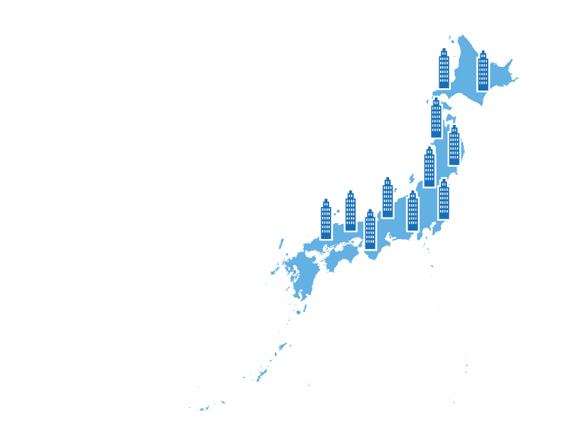
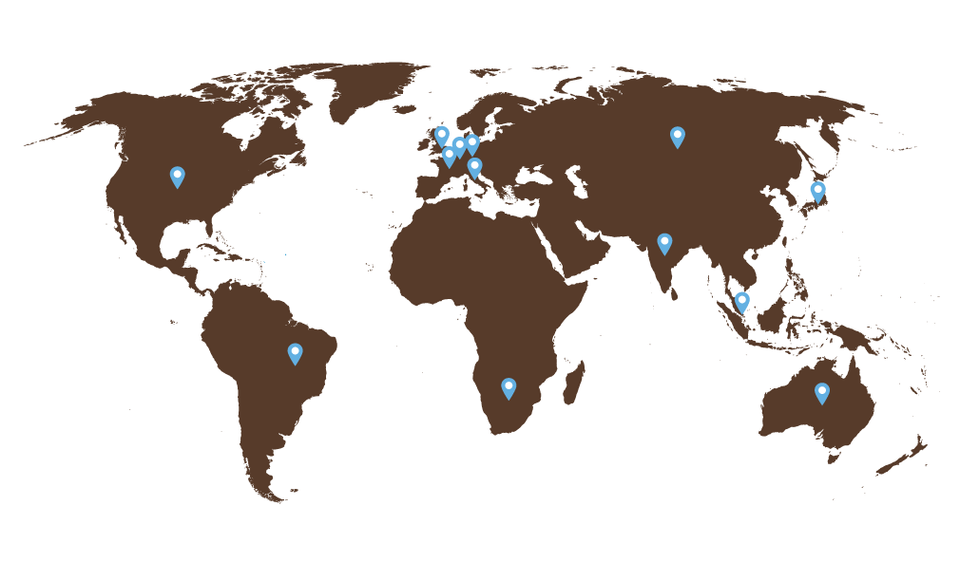
Over 1,500
organizations do <IR>
83%
of CEOs, CFOs and other C-suite executives surveyed believe that adopting <IR>
would help deliver success
to their organizations
2,000 participating in <IR> Networks worldwide
Over 300 companies have adopted <IR> in Japan
Notes:
Over 1,500 organisations are now doing some form of Integrated Reporting.
83% of CEOs, CFOs and other C-suite executives believe that adopting <IR> would help deliver success to their organizations. This is according to a recent survey of 400 leaders by CIMA, AICPA and Black Sun. (http://integratedreporting.org/wp-content/uploads/2016/12/2016-Value-of-Value-Board-Level-Insights-1.pdf)
2,000 participating in <IR> Networks worldwide
Over 300 businesses in Japan have adopted integrated reporting, according to Japanese government sources.

Slide 4
Australia:
The <IR> Pension Fund Network is based in Australia where leading funds are adopting Integrated Reporting.
Business Reporting Leaders Forum active towards Integrated Reporting

Slide 5
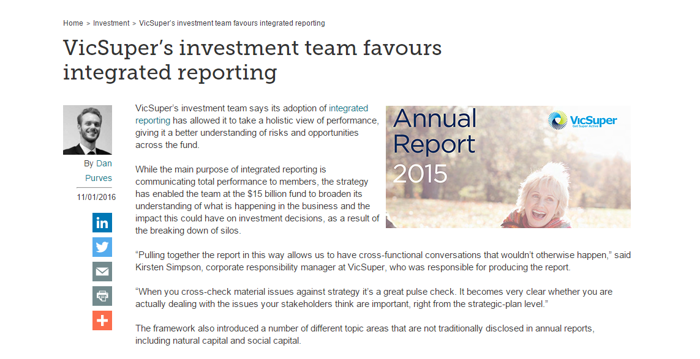
Source: Investment Magazine
Notes:
“VicSuper’s investment team says its adoption of integrated reporting has allowed it to take a holistic view of performance, giving it a better understanding of risks and opportunities across the fund.
While the main purpose of integrated reporting is communicating total performance to members, the strategy has enabled the team at the $15 billion fund to broaden its understanding of what is happening in the business and the impact this could have on investment decisions, as a result of the breaking down of silos.”
See full article at: https://investmentmagazine.com.au/2016/01/vicsupers-investment-team-favours-integrated-reporting/

Slide 6
Brazil:
Brazilian Stock Exchange BM&FBOVESPA encourages listed companies to produce integrated reports on a ‘report or explain’ principle.
The <IR> network in Brazil has over 500 participants with over 100 organizations producing integrated reports.
Notes:
For further information on the <IR> Network in Brazil, see presentation slides from IFAC <IR> PAO Network webinar #3 October 18, 2016.
download here: https://www.ifac.org/user/login?destination=/extranet/resources#Integrated%20Reporting%20PAO%20Network

Slide 7
China:
The Ministry of Finance in China has joined the IIRC Council and included Integrated Reporting in its five year plan.
CNG Limited – China’s largest nuclear power company is a vocal advocate for Integrated Reporting

Slide 8
Europe:
European Commission describes <IR> as “a step-ahead” of its directive on non-financial reporting
<IR> Networks are active in countries including France, Germany, Italy, Netherlands, Turkey, Switzerland and the UK

Slide 9
France:
Many of the top listed companies (CAC 40) now adopting <IR> including BNP Paribas, AXA, Crédit Agricole, Danone, L’Oréal, Sanofi, Vivendi and Engie

Slide 10
Germany:
Many leading organizations now adopting <IR> including BASF, Deutsche Bahn, Deutsche Börse Group, EnBW, Flughafen Muenchen Group, and SAP SE
Notes:
Deutsche Börse Group is one of the largest exchange organizations worldwide.

Slide 11
The Netherlands:
More than a third of Dutch listed companies are working towards <IR>
Eumedion, which represents institutional investors’ interests, has called on Dutch companies to take concrete steps towards <IR>

Slide 12
United Kingdom:
Close alignment to the UK strategic reporting requirements means that UK companies are firmly on the journey to <IR>
The UK regulator the FRC has said that companies preparing high-quality strategic reports should be aligned to <IR>
UK Treasury has called on public sector organizations to adopt <IR>

Slide 13
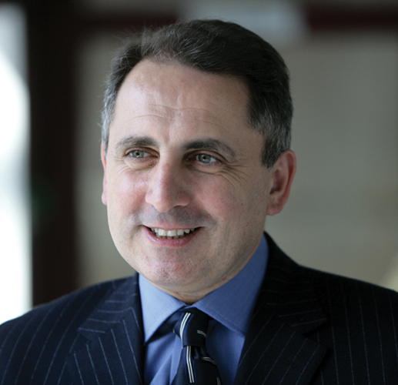
“We use different words in the UK. Strategic Report, not Integrated Report, but we are on the same journey with the same purpose. The principles in a UK strategic report are consistent with an integrated report. And we look forward to continuing to work closely with the IIRC as it pursues its mission in the years ahead.”
Stephen Haddrill, CEO, Financial Reporting Council, UK

Slide 14
India:
The Securities and Exchange Board of India has written to the top 500 Indian companies encouraging the adoption of Integrated Reporting
The Indian <IR> Lab is led by the Confederation of Indian Industries and includes leading companies such as Tata, Mahindra & Mahindra and YES Bank

Slide 15
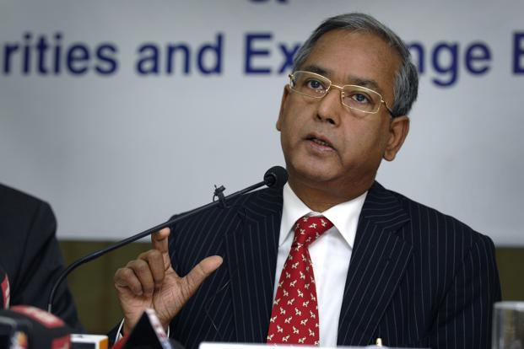
Securities and Exchange Board of India Wants Yearly Tell-All Accounts
“Whether integrated reporting will happen is no longer a question. We should look at how to implement it in a manner that is not disruptive”
U.K. Sinha, Former Chair, Securities and Exchange Board of India

Slide 16
Japan:
Over 300 companies have adopted Integrated Reporting
Japan's Ministry of Economy, Trade and Industry has endorsed <IR> as a means of communicating the long-term value creation proposition of companies.
Notes:
Listen to IFAC <IR> PAO Network webinar #2 June 21, 2016 for more information
(download here: https://www.ifac.org/user/login?destination=/extranet/resources#Integrated%20Reporting%20PAO%20Network)

Slide 17
Malaysia:
Malaysian government and securities commission have spoken of Integrated Reporting as a tool to enhance the quality of information available to the market.
Corporate governance code encourages adoption of <IR>
Over 20 of Malaysia’s largest businesses have made a public commitment to adopting <IR>

Slide 18
Singapore:
Singapore Stock Exchange guidance refers to Integrated Reporting
Leading businesses such as DBS Bank, City Developments Limited and the Maritime & Port Authority are paving the way towards <IR> adoption.

Slide 19
South Africa:
Companies listed on the Johannesburg Stock Exchange have been producing integrated reports since 2010
<IR> is at the core of corporate governance and reporting through the King code on corporate governance which is explicitly aligned to the <IR> Framework.

Slide 20
United States:
Businesses adopting <IR> include PepsiCo, Microsoft, GE and Prudential Financial
Larry Fink, CEO, Black Rock called for CEOs to communicate their strategic framework for long-term value creation
The largest US public pension fund CalPERS has called on boards to provide an integrated report

Slide 21
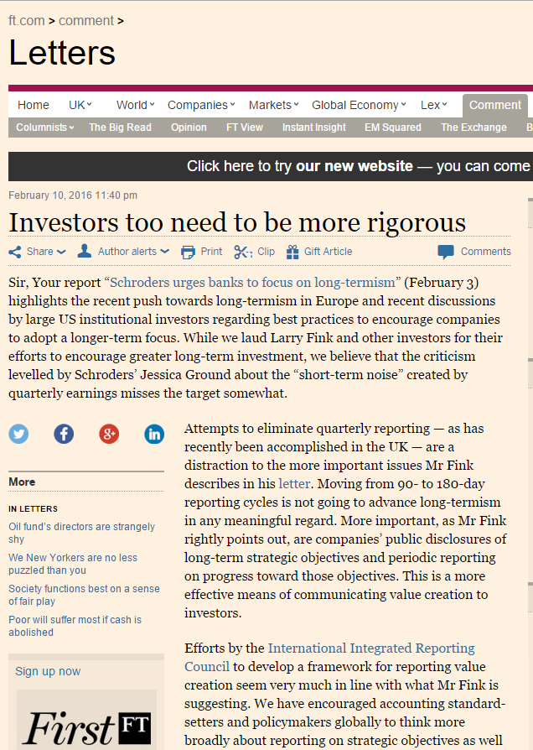
“We are asking that every CEO lay out for shareholders each year a strategic framework for long-term value creation. Additionally, because boards have a critical role to play in strategic planning, we believe CEOs should explicitly affirm that their boards have reviewed those plans. BlackRock’s corporate governance team, in their engagement with companies, will be looking for this framework and board review.”
Larry Fink, CEO, BlackRock
"Efforts by the International Integrated Reporting Council to develop a framework for reporting value creation seem very much in-line with what Mr Fink is suggesting."
Sandra Peters, Head of Global Financial Reporting Policy, CFA Institute
Notes:
Investors are now saying that they need more than financial information in order to make informed investment decisions.
On February 1, 2016 Larry Fink, CEO of the world’s largest asset manager, BlackRock wrote to the Chief Executives of S&P 500 companies and large European organizations, setting out a vision to overcome short-termism and urging greater transparency over longer term strategy and growth plans. In the letter he says:
“We are asking that every CEO lay out for shareholders each year a strategic framework for long-term value creation. Additionally, because boards have a critical role to play in strategic planning, we believe CEOs should explicitly affirm that their boards have reviewed those plans. BlackRock’s corporate governance team, in their engagement with companies, will be looking for this framework and board review.”
The primary purpose of an integrated report is to improve the quality of information available to providers of financial capital by communicating broader and more relevant information that can assist in effective capital allocation decisions. And as Larry Fink says in his letter, “one reason for investors’ short-term horizons is that companies have not sufficiently educated them about the ecosytems they are operating in, what their competitive threats are and how technology and other innovations are impacting their businesses.”
[You can read the full letter here: https://www.blackrock.com/corporate/en-no/literature/press-release/2016-larry-fink-ceo-letter.pdf]
This powerful call for change is a perfect example of what the IIRC is trying to achieve through the global introduction of Integrated Reporting.
Commenting on the letter, Sandra Peters, Head of Global Financial Reporting Policy, CFA Institute said, “Efforts by the International Integrated Reporting Council to develop a framework for reporting value creation seem very much in-line with what Mr Fink is suggesting.”
[Taken from the FT article: https://www.ft.com/content/bde4e2ec-cc07-11e5-be0b-b7ece4e953a0)]

Slide 22
Global:
IIRC playing a key role in Task Force on Climate-related Financial Disclosures
IFAC advocating for <IR> as future of corporate reporting
<IR> firmly on the G20 agenda
<IR> key for reaching Sustainable Development Goals and COP21

Slide 23
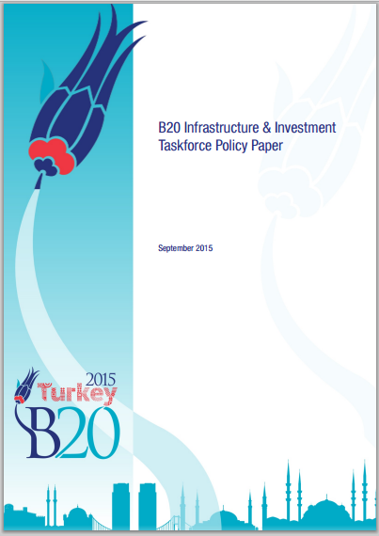
Notes:
The B20 (the G20's business arm) recommended promoting integrated reporting as a key means of improving SME reporting with a view to building trust around past and future performance.

Slide 24
“By improving reporting requirements for organisations <IR> will lead to better-informed and more sustainable long-term investment, for the benefit of society.” Mark Carney, Governor Bank of England, Chairman, Financial Stability Board

Slide 25
“We find that Integrated Reporting is positively associated with both stock liquidity … and firm value ...” Mary E. Barth, Stanford University; Steven F. Cahan & Li Chen, University of Auckland; Elmar R. Venter, University of Pretoria

Slide 26
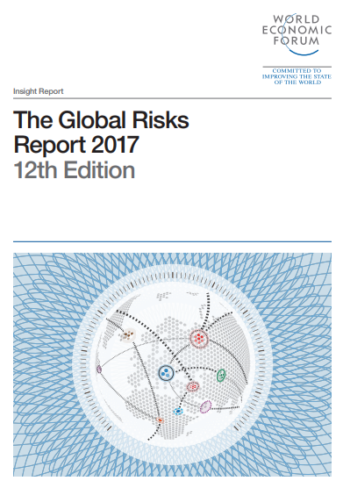
“conceptual models are needed to define, characterise and measure the potential negative impacts of interconnected global risks.”
WEF Chairman, Klaus Schwab, 2014
Notes:
[Link to WEF Global Risks Report 2017, 12th Edition: http://www3.weforum.org/docs/GRR17_Report_web.pdf ]
Evidence that the role of an organization is broadening can be found in many of the major publications of international bodies such as the UN and the World Economic Forum.
It is fascinating to track the progress of WEF’s Global Risks reports over the years, and in particular the growing importance of natural and human capital-related risks such as climate change and migration.
In 2014, the report highlighted the growing interconnectedness between risks, emphasising that it is no longer possible to isolate risk management – instead, a holistic approach is needed. In 2015, water shortages emerged as the number one risk, the first time an issue outside the realm of “core financials” topped the table of global risks. In 2016, not only does a failure of climate change mitigation emerge as the most significant risk in terms of impact, but the report highlights the differences in recorded risks according to the time horizon in the respondent’s mind at the time. And in 2017, weapons of mass destruction topped the list in terms of impact, with the remaining 4 risks in the top 5 all being either environmental or societal.
In his preface to the 2014 Global Risks Report, WEF Chairman Klaus Schwab said that, “conceptual models are needed to define, characterise and measure the potential negative impacts of interconnected global risks”.
The multi-capitals framework the IIRC has introduced to the lexicon and practice of corporate reporting is one such model. It is encouraging to see the number of businesses (and indeed countries) that are starting to think, plan and make decisions by reference to the International <IR> Framework, which gives parity to human, social, environmental and intellectual capitals alongside the traditional forms of capital that have dominated economic and business discourse for so long.
WEF shows, year after year, that managing the risks associated with each of the capitals is no longer an option; it is essential to the successful management of the business and will have a direct impact on its cost of capital and reputation. Over the last year, investors and regulators have increased the volume of their demands for information in context.

