Slide 1
These slides are shared with members of the Integrated Reporting PAO Network with limited design elements so that you can add your organization’s branding/template.
Please contact Laura Leka (lauraleka@ifac.org) if you would like to include the IFAC and/or IIRC logo(s).

Slide 2
Introduction to Integrated Reporting

Slide 3
Overview
About the IIRC
A new corporate reporting model
The International <IR> Framework
Notes:
2nd dot point: mention here that <IR> is about “Corporate reporting”, not financial reporting or sustainability reporting or narrative reporting (like MD&A or management commentary), or simply combining the these– it goes further and deeper than that.

Slide 4
The
International
Integrated Reporting
Council
Notes:
The development of <IR> is based on key insights:
Increasing value in business is driven by a range of capitals
Reporting is fragmented – the story is lost in detail
Users want to read about value creation over time
Reporting can influence better outcomes
Not just financial but wider matters
Better reporting can help to unlock long-term investment

Slide 5
Who is the IIRC?
Companies
Investors
NGOs
Regulators
Accounting
Standard
setters
Notes:
The International Integrated Reporting Council (IIRC) is a global coalition of regulators, investors, companies, standard setters, the accounting profession and NGOs. The coalition is promoting communication about value creation as the next step in the evolution of corporate reporting.
The IIRC is chaired by Professor Mervyn King. Paul Druckman (now Chair of the UK FRC’s Corporate Reporting Council) was the initial Chief Executive Officer. The “new” (November 2016) CEO is Richard Howitt, former Member of the European Parliament and key architect of the EU’s non-financial reporting directive.
Members of the IIRC Council are at:
http://integratedreporting.org/the-iirc-2/structure-of-the-iirc/council/
- it usually helps to mention some of the people/organizations who are known globally or in your jurisdiction.
For more names/organizations see also:
http://integratedreporting.org/the-iirc-2/structure-of-the-iirc/the-iirc-board/ and
http://integratedreporting.org/the-iirc-2/structure-of-the-iirc/ambassadors/

Slide 6
IIRC Vision
The IIRC’s vision is to align:
  capital allocation, and
  corporate behaviour
to wider goals of:
  financial stability, and
  sustainable development
through the cycle of:
  integrated reporting, and
  integrated thinking.
Notes:
Can read whole slide, then for emphasis click on the animations, noting that:
[FIRST CLICK] there is an EXTERNAL FOCUS: an integrated report that meets the information needs of investors will help with more efficient allocation of financial capital
[SECOND CLICK] and an INTERNAL FOCUS: changing corporate behavior and the mindset of directors and management through integrated thinking, which is a systems based approach recognising that a business is a collection of sub-systems that, to be successful, have to interact with each other better than they do now, so that, as Aristotle says “The whole is greater than the sum of its parts”.
[THIRD CLICK] THESE 2 FOCUSES will help achieve the two wider goals of financial stability and sustainability development. Again, taking a systems view, we recognize that corporate reporting is only one part of the web of complex systems that determine these broader goals; i.e., we do what we can to enhance reporting and thinking, but of course we are not claiming <IR> of itself will solve all problems.

Slide 7
Six Strategic Themes
pace and scale
leading practice and guidance
bridge to investors
progress through dialogue
engage with global policy
viable organization
Notes:
For more info see http://integratedreporting.org/wp-content/uploads/2015/02/IIRC-Strategy-Summary-2015.pdf
<IR> is in the Breakthrough Phase (2014-2017) – the move from the creation of the International <IR> Framework and market testing to development and early adoption by reporting organizations around the world. The IIRC’s objective for the Breakthrough Phase is to achieve a meaningful shift towards early adoption of the International <IR> Framework. The objective is being achieved through a number of strategic themes:
Increasing the pace and scale of adoption – Further slides on this topic available – contact LauraLeka@ifac.org
Maintaining the Framework, guidance and examples see http://integratedreporting.org/news/clarify-simplify-amplify-global-consultation-results-on-the-progress-towards-integrated-reporting/
Building a bridge from corporate reporting to capital allocation through ‘integrated investment’ – see http://integratedreporting.org/resource/investor-statement/
Progress through dialogue: developing the Corporate Reporting Dialogue inspired by extensive innovation in corporate reporting globally – see http://integratedreporting.org/corporate-reporting-dialogue/ [Further slides are available on the CRD – contact LauraLeka@ifac.org]
Engagement with the global policy and regulatory community to ensure is encouraged to flourish
Developing a long-term, viable organization

Slide 8
Through <IR> we are seeing progress in…
Notes:
Capital allocation aligned to financial stability and sustainable development
Long-term value creation
Internal decision-making and confidence in metrics
Decision-useful reporting for investors – see, e.g., http://integratedreporting.org/resource/investor-statement/
Dialogue between frameworks and standard setters –Effective and efficient reporting – see http://integratedreporting.org/corporate-reporting-dialogue/

Slide 9
A new corporate reporting model
Notes:
Buckminster Fuller “You never change things by fighting the existing reality. To change something, build a new model that makes the existing model obsolete.”
The development of <IR> is based on key insights:
Increasing value in business is driven by a range of capitals
Reporting is fragmented – the story is lost in detail
Users want to read about value creation over time
Reporting can influence better outcomes
Not just financial but wider matters
Better reporting can help to unlock long-term investment
See Discussion Paper http://integratedreporting.org/resource/discussion-paper/ for further info about background

Slide 10

Integrated Reporting is enhancing the way organizations
Plan
Think
Report
the story of their business
Notes:
What is Integrated Reporting? Integrated Reporting is enhancing the way organizations think, plan and report the story of their business.

Slide 11
It is helping businesses to think holistically about
strategy and plans
make informed decisions
manage key risks
to build investor and stakeholder confidence and improve future performance
Notes:
<IR> is helping businesses to think holistically about their strategy and plans, make informed decisions and manage key risks to build investor and stakeholder confidence and improve future performance. It is shaped by a diverse coalition including business leaders and investors to drive a global evolution in corporate reporting.

Slide 12
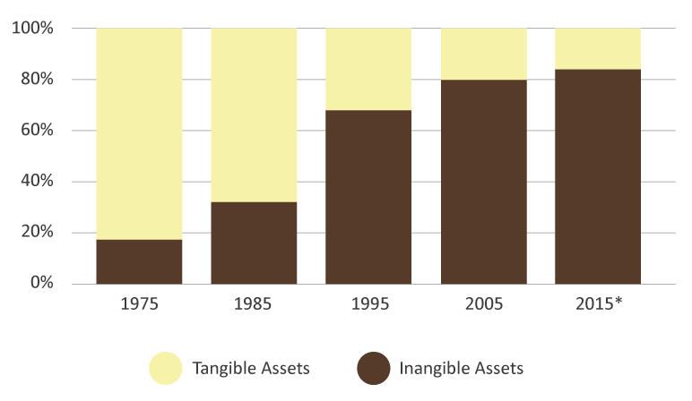
Value is more than financial
Source: OCEAN TOMO LLC
January,1,2015
Notes:
This graph shows the break up of the market capitalization of S&P’s top 500 US companies.
It demonstrates that 40 years ago over 80% of market cap was explained by net assets in the f/s. Now that position has completely reversed; less than 20% can be explained through the balance sheet.
What explains the rest? Other factors, such as relationships, intellectual and human capital, make up an increasing proportion of a company’s value.
Instead of focusing on financial capital, we have introduced a multiple capitals model to reporting. <IR> enables allows investors to evaluate how all material capitals that a business uses and affects relate to value creation in the short, medium and long term.
The IIRC is not trying to monetize everything (which is a common misperception), but rather is trying to ensure investors have the information they need to assess the ability of an organization to create value over time.

Slide 13

The reporting mismatch
Reporting Content
Business Value
Strategic Issues
Strategy
and Governance
Forecasts/Plans
Implementation Plans
Past Performance
Business as usual
© International Integrated Reporting Council
Notes:
Reporting has not been keeping pace with changes in what creates value. It too often still focuses primarily on past performance, particularly financial performance; pays little attention to the future or factors that drive value creation.
<IR> shifts the focus to strategy and future orientation, rebalancing the current mismatch between what is reported and those factors that impact value. <IR> ensures issues central to value are getting the attention they deserve, enabling investors to have the information they need to get a clear picture of the long term. Currently capital markets compensate for not having this information by pricing in risks that may well be adequately managed.

Slide 14
New reports to meet new information needs
Piecemeal addition of “bits” of information
  Explosion of disconnected information
  Reporting overload and a compliance mindset
  Material information lost in the detail
Notes:
We have ended up with
New reports to meet new information needs, and
Piecemeal addition of “bits” of information
REGULATORS/STANDARD-SETTERS/POLICY MAKERS often require more info, so we get an explosion of disconnected information
MAKING PREPARERS SUFFER reporting overload, which induces a checklist/compliance mindset
BUT FROM THE USERS PERSPECTIVE, it gets harder to tell what is actually important: material information gets lost in the detail
What is needed is a strategic re-think of what reporting should be

Slide 15
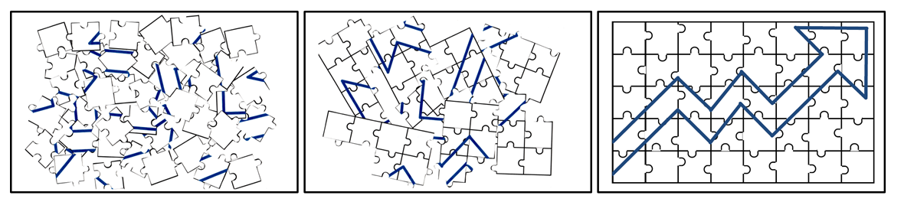
Towards a solution:
Value creation
Not just financial
Concise
Strategic focus
Future orientation
Connected
An integrated report should “tell a story”
Notes:
<IR> is that strategic re-think.
Some elements of the <IR> solution are:
To focus on value creation rather than just financial information (or just on ESG “impacts”, as in sustainability reports)
This requires a strategic focus in the report (and in the thinking that leads to it)
And an emphasis on longer term implications – not only the short (or medium) term
Which requires a future orientation in the report (and in the thinking that leads to it)
An integrated report should also be concise – this is a very important point. <IR> is not about MORE reporting, it is about BETTER reporting
And to be better, it needs to be “connected” - like in the diagram. The first image has all the same pieces as the final image, but unless the pieces are connected, then they are meaningless – they don’t tell a story. An integrated report needs to tell the organization’s unique value creation story.

Slide 16
How is integrated reporting different?
Thinking: | Isolated | → | Holistic
Stewardship: | Financial capital | → | All forms of capital
Focus: | Past, financial | → | Past and future, connected, strategic
Timeframe: | Short term | → | Short, medium and long term
Trust: | Narrow disclosures | → | Greater transparency
Adaptive: | Rule bound | → | Principles based
Concise: | Long and complex | → | Concise and material
Technology: | Paper based | → | Technology enabled
Notes:
*****YOU MIGHT WANT TO USE EITHER THIS SLIDE OR THE NEXT ONE******
THIS ONE IS FROM page 9 of the 2011 Discussion Paper http://integratedreporting.org/resource/discussion-paper/
Thinking : “Because traditional reporting occurs in silos, it encourages thinking in silos. Integrated Reporting, on the other hand, reflects, and supports, integrated thinking – monitoring, managing and communicating the full complexity of the value creation process and how this contributes to success over time. Integrated Reporting demonstrates the extent to which integrated thinking is occurring within the organization. “
Stewardship: “Integrated Report displays an organization’s stewardship not only of financial capital, but also of the other “capitals” (manufactured, human, intellectual, natural and social), their interdependence and how they contribute to success. This broader perspective requires consideration of resource usage and risks and opportunities along the organization’s full value chain.
Focus: Annual reporting at present is largely focused on past financial performance and financial risks. Other reports and communications may cover other resources and relationships, but they are seldom presented in a connected way, or linked to the organization’s strategic objectives and its ability to create and sustain value in the future.”
Timeframe : “Much of the media and regulatory attention in response to the global financial crisis has focused on “short-termism” as one contributory factor. Although short-term considerations are important in many ways, placing them in context is also essential. Integrated Reporting specifically factors in short-, medium- and long-term considerations.”
Trust : “Financial reporting focuses primarily on a narrow series of mandated disclosures. Although an increasing number of organizations are improving their transparency, for example, through voluntary sustainability reporting, in absolute terms that number is still low. By emphasizing transparency, for example, covering a broader range of issues and disclosing the positive with the negative, Integrated Reporting helps to build trust.”
Adaptive : “Today’s reporting is often said to be too compliance orientated, reducing the scope for organizations to exercise an appropriate amount of judgement. While a certain level of compliance orientation is necessary to ensure consistency and enable comparison, Integrated Reporting offers a principles-based approach that drives greater focus on factors that are material to particular sectors and organizations. It permits an organization to disclose its unique situation in clear and understandable language.”
Concise: “Long and complex reports are often impenetrable for many readers. A key objective for Integrated Reporting is to de-clutter the primary report so that it covers, concisely, only the most material information. “
Technology enabled: “While the internet and XBRL are introducing elements of technological innovation, many corporate reports are still presented as if they were entirely paper based. Integrated Reporting takes advantage of new and emerging technologies to link information within the primary report and to facilitate access to further detail online where that is appropriate.”

Slide 17
Integrated: holistic, systems-based
Organization ↔ its external environment
Organization as a whole ↔ its component parts
Past (accountability) ↔ present ↔ future (decisions)
Short term ↔ medium term ↔ long term
Strategy ↔ governance ↔ performance ↔ prospects
Inputs ↔ business model ↔ outputs ↔ outcomes
Value for the organization ↔ value for others
Financial ↔ non-financial
Quantitative ↔ qualitative
Notes:
*****YOU MIGHT WANT TO USE EITHER THIS SLIDE OR THE PREVIOUS ONE******
The “connectivity of information” is one of <IR>’s Guiding Principles. It requires a holistic, systems-based approach to thinking and reporting. For example:
Organization connected with its external environment: A good integrated report will connect information about the organization with information about the environment it operates in (economic, political, competition, technology, etc. that are affecting the organization’s ability to create value)
Organization as a whole connected with its component parts: Organizations are systems that are made up of sub-systems. The sub-systems are often in silos. <IR> tries to break down (or at least ensure synergy between) the silos
Etc (can essentially just read most of these points)
Re “Value for the organization ↔ value for others” – see para 2.2 of the Framework – Value is not created by any organization alone, it is co-created and needs different resources and relationships (capitals). Para 2.6: to create value for itself, an organization has to create value for others. Showing the relationship between value for the organization and value for others is an important part of helping users understand longer term prospects.

Slide 18
The International <IR> Framework
Notes:
The Framework was released in December 2013 after a rigorous due process spanning 3 years. It was preceded by a Discussion Paper, an prototype of the Framework, and a Consultation Draft on which several hundred submissions were received.
http://mailchi.mp/theiirc/iirc-newsletter-690290
Results published in October 2017 from the first worldwide consultation on how companies are adopting Integrated Reporting since the International <IR> Framework was released, show how the focus has moved from one of initial acceptance to progress in actual implementation.
The consultation into the adoption of Integrated Reporting conducted over two months in early 2017, received over 400 contributions including from focus groups held in 19 countries around the world.
The review found that the <IR> Framework, is standing up to the test of implementation. It demonstrated that the concepts of Integrated Reporting have been widely accepted and embraced, with the focus now on enabling better implementation.
Based on these results, the IIRC found no new or compelling arguments to indicate a need for Framework revision in the near term. The IIRC does not plan to initiate a formal Framework revision process until at least 2019.

Slide 19
The International <IR> Framework aims to:
Efficient and productive allocation of capital
Support
Integrated
thinking
Cohesive and efficient approach to corporate reporting
Enhance accountability
Notes:
(Page 2 of the Framework)
<IR> aims to:
Improve the quality of information available to providers of financial capital to enable a more efficient and productive allocation of capital
Promote a more cohesive and efficient approach to corporate reporting that draws on different reporting strands and communicates the full range of factors that materially affect the ability of an organization to create value over time
Enhance accountability and stewardship for the broad base of capitals (financial, manufactured, intellectual, human, social and relationship, and natural) and promote understanding of their interdependencies
Support integrated thinking, decision-making and actions that focus on the creation of value over the short, medium and long term.

Slide 20

A concise communication about value creation over time
Financial
reporting
Strategy, governance,
performance, prospects
Other
reporting
Notes:
<IR> draws on financial reporting, as well as other forms of reporting, such as sustainability reporting, management commentary, governance and remuneration reporting, carbon reporting, etc., and other communications, such as analyst calls and the investor relations section of an organization’s website.
It draws together information from these other sources as they relate to strategy, governance, performance and prospects, and makes the links and connections between them to provide a clear, coherent and, importantly, concise communication about the ability of the organization to create value.
While <IR> (page 2 of the Framework) “is consistent with developments in financial and other reporting, an integrated report also differs from other reports and communications in a number of ways. In particular, it focuses on the ability of an organization to create value in the short, medium and long term, and in so doing it:
is a concise communication about how an organization’s strategy, governance, performance and prospects, in the context of its external environment, lead to the creation of value over the short, medium and long term.
has a combined emphasis on conciseness, strategic focus and future orientation, the connectivity of information, and the capitals and their interdependencies
emphasizes the importance of integrated thinking within the organization.”

Slide 21
Core features
INTRODUCTION
GUIDING PRINCIPLES
CONTENT ELEMENTS
USING THE FRAMEWORK
FUNDAMENTAL CONCEPTS
  THE CAPITALS
  VALUE CREATION
Notes:
The Framework has 3 core parts, which I would like to quickly walk you through:
An Introduction that has a section on how to use the Framework, and a section on fundamental concepts that explains the foundations or conceptual underpinning of <IR>,
Guiding Principles that inform the content of an integrated report and how information in the report is presented, and
Content Elements, which are essentially categories of information that is to be included in an integrated report.
The Fundamental Concepts are about what we call “the capitals” and about value creation

Slide 22
The capitals
Financial capital
Manufactured capital
Social and relationship
capital
Intellectual
capital
Human
capital
Natural capital
Notes:
Traditionally, “capital” has been thought of as the money and machines available for production; what the Framework calls Financial Capital and Manufactured Capital. These have been accounted for in financial statements since the beginning of double-entry bookkeeping.
But “Capital” in this sense is only one part of what are commonly called the “factors of production”, i.e., “land, labour and capital”. And any business needs all these factors of production to prosper.
The fact is that the other factors of production (land and labour) are actually forms of capital too, in that they store value that can be enhanced, consumed, modified, destroyed or otherwise affected by an organization.
So in reality, all organizations depend on a whole range of capitals (or “resources and relationships”) for their continued success; and can also affect a whole range of capitals even if it doesn’t actually use them (e.g., a factory can extract clean water from a river and use it, but release polluted waste water downstream)
To get the full picture of an organization’s ability to create value, therefore, all the capitals need to be considered.
The Framework classifies the capitals as, starting with the traditional ones: (see para 2.16 for more detail)
FINANCIAL: The pool of funds an organization has access to
MANUFACTURED: Plant, machinery and infrastructure
Then there is a layer of capitals that have to do with humans (the equivalent of “labour” in the factors of production)
INTELLECTUAL: Organizational, knowledge-based intangibles. Not just IP, but also informal “organizational capital” such as tacit knowledge, systems, procedures and protocols
HUMAN: People’s competencies, capabilities and experience and their motivations to innovate
SOCIAL AND RELATIONSHIP: The institutions and relationships established within and between communities, groups of stakeholders and other networks, and their ability to share information, to enhance individual and collective well-being.
And finally there is natural capital (the equivalent of “land” in the factors of production)
NATURAL: Both renewable and non-renewable environmental resources and processes.
The Framework recognises that this categorization won’t necessarily suit all organization, so the idea is not to force everyone to structure their reports around these particular capitals, but rather to use this categorization as a benchmark to ensure all resources or relationships that are material to each organization are considered (para 2.17-.19).
It is also not the intention that all these capitals be monetized or even necessarily measured, often narrative may be the best way for an organization to explain how it uses or affects a particular capital (para 1.11).
This conception of the capitals will necessarily result in broader disclosures than the traditional reporting. It will include consideration of capitals that the organization uses or affects whether or not they are owned by the organization (e.g., para 3.15-3.16, and 4.20). It will involve disclosing significant trade-offs the organization is making between various capitals over time (para 4.56). And it will involve considering how the future availability, quality and affordability of various capitals (including non-renewable resources) will affect the ability of the organization to create value (e.g., para para 4.56 - a search on the term “availability, quality and affordability” is instructive) .
Some people have difficulty distinguishing between the intellectual, human, and social and relationship capitals. The Capitals Background Paper http://integratedreporting.org/resource/background-papers/ at 4.23 says “Perhaps the simplest way to differentiate between human capital, social and relationship capital, and intellectual capital as used by the IIRC is to view them from the point of view of the “carrier” of each:
For human capital, the carrier is the individual person
For social and relationship capital, the carrier is intra/extra-organizational networks
For intellectual capital, the carrier is the organization.

Slide 23
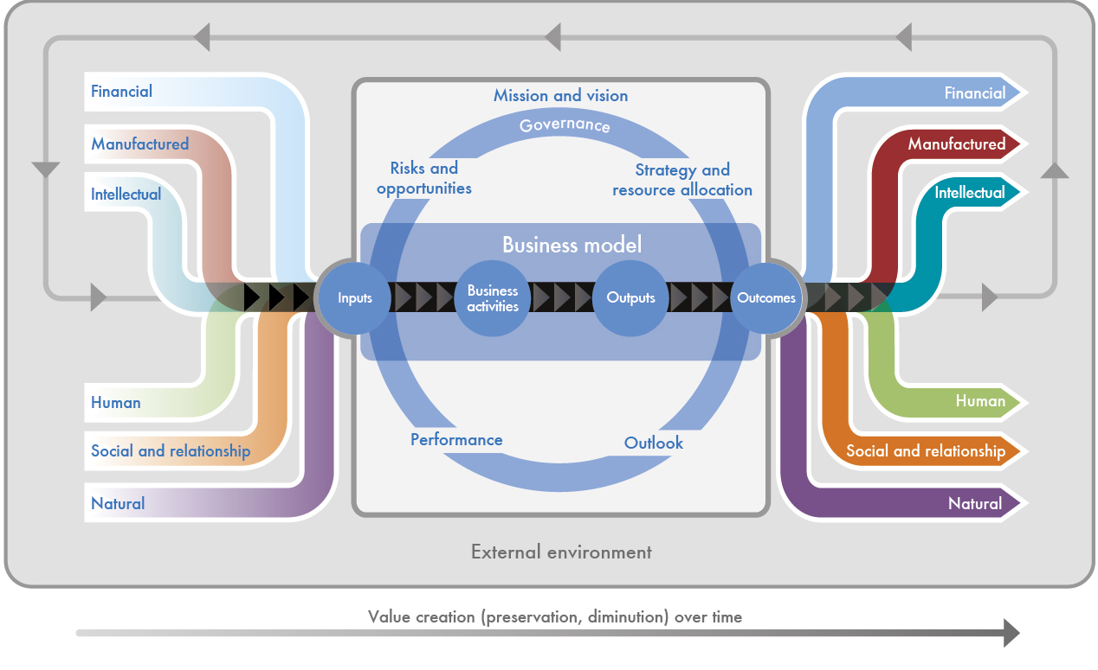
The capitals and value creation
The organization
Notes:
This “octopus diagram” depicts the essence of <IR>:
An organization (the box in the middle) creates (or destroys) value over the time by using, and affecting, the capitals (or resources and relationships – the coloured ribbons going into and out of the organization) (financial, manufactured, intellectual, human, social and relationship, and natural) in the context of the external environment the organization is (including the legal, commercial, social, environmental and political context that affect the organization). Value created, or destroyed, is stored in the capitals that flow through the organization. [Can talk about the capitals in more detail here or hereabouts if wanted – see extra slide at end of this deck – slide 31].
The value creation process is not static; regular review of each component and its interactions with other components, and a focus on the organization’s outlook, leads to revision and refinement to improve all the components [this is the grey arrow that connects the “end stock” of capitals with the “beginning stock” for the next period].
What goes on inside the grey box determines how the organization interacts with the external environment, what capitals it uses and how it affects them.

Slide 24
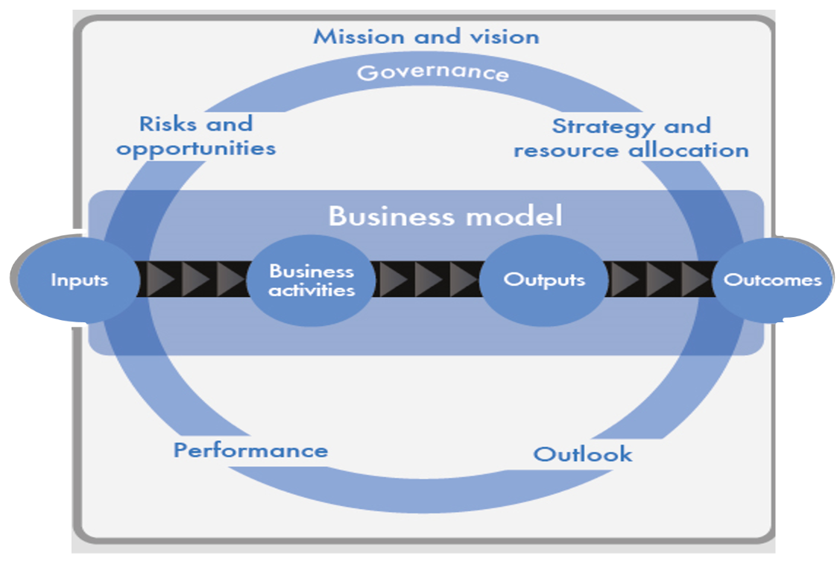
Inside the organization
Notes:
At the core of the organization is its business model, which draws on various capitals as inputs and, through its business activities, converts them to outputs (products, services, by-products and waste). The organization’s activities and its outputs lead to outcomes in terms of effects on the capitals.
The labels inside the grey box are, essentially, the Framework’s “Content Elements”, which we will come back to briefly in a minute.

Slide 25
The complete picture
Notes:
If an organization can articulate, concisely, how this value creation model works in its particular circumstances, then it will have its integrated report = the organization’s unique value creation story.

Slide 26
Core features
INTRODUCTION
GUIDING PRINCIPLES
CONTENT ELEMENTS
USING THE FRAMEWORK
FUNDAMENTAL CONCEPTS
  THE CAPITALS
  VALUE CREATION
STRATEGIC FOCUS AND FUTURE ORIENTATION
CONNECTIVITY OF INFORMATION
STAKEHOLDER RESPONSIVENESS
MATERIALITY
CONCISENESS
RELIABILITY AND COMPLETENESS
CONSISTENCY AND COMPARABILITY
Notes:
There are 7 Guiding Principles that inform the content of an integrated report and how information is presented.

Slide 27
STRATEGIC FOCUS AND FUTURE ORIENTATION
CONNECTIVITY OF INFORMATION
STAKEHOLDER RESPONSIVENESS
MATERIALITY
CONCISENESS
RELIABILITY AND COMPLETENESS
CONSISTENCY AND COMPARABILITY
Notes:
There are 7 Guiding Principles that inform the content of an integrated report and how information is presented.
The flavour of each of the Guiding Principles is fairly obvious from its title:
An integrated report should focus on strategy and, while including past performance, it should be orientated towards the need for readers to make decisions about the future.
Connectivity of information is a particularly important principle. It’s both unique and intrinsic to <IR>. Connectivity is about understanding the myriad of interrelationships and interdependencies between the different capitals; between the past, the present and the future; between financial information and other information; between information in the integrated report, information in other communications, and information from outside the organization; and presenting that in a connected way throughout the report. Connectivity is absolutely integral to the breaking down of silos within an organization and paving the way for truly integrated thinking.
The principle of stakeholder responsiveness is an overt recognition of the fact that value is not created by or within an organization alone, but is created through relationships with others. <IR> emphasizes the importance of on-going, positive relationships with key stakeholders and requires that an integrated report to provide insight into the quality of the organization’s relationships with key stakeholders and how and to what extent the organization understands, takes into account and responds to their legitimate needs, interests and expectations.
An integrated report should include materiality matters; be concise as a standalone communication, albeit linked to other reports and communications for those stakeholders who want additional detail; be reliable, complete and consistent from period to period. It should also be comparable with other organization’s reports to the extent that doesn’t cloud or overwhelm the need for each organization to tell its own, unique, value creation story.

Slide 28
Core features
INTRODUCTION
GUIDING PRINCIPLES
CONTENT ELEMENTS
USING THE FRAMEWORK
FUNDAMENTAL CONCEPTS
  THE CAPITALS
  VALUE CREATION
STRATEGIC FOCUS AND FUTURE ORIENTATION
CONNECTIVITY OF INFORMATION
STAKEHOLDER RESPONSIVENESS
MATERIALITY
CONCISENESS
RELIABILITY AND COMPLETENESS
CONSISTENCY AND COMPARABILITY
… OVERVIEW and EXTERNAL ENVIRONMENT
GOVERNANCE
BUSINESS MODEL
RISKS and OPP’S
STRATEGY and RESOURCE ALLOCATION
PERFORMANCE
OUTLOOK
BASIS …
Notes:
The Content Elements are categories of information that should appear in an integrated report.

Slide 29
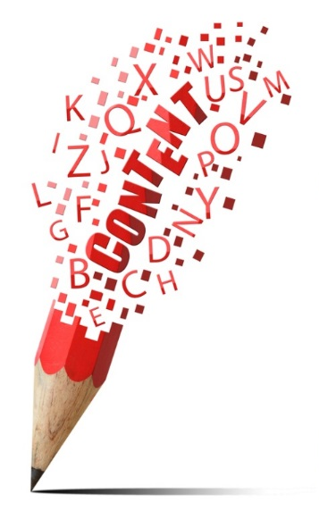
Questions to be answered
Unique story
Connections apparent
Not a set sequence
Not isolated, standalone sections
… OVERVIEW and EXTERNAL ENVIRONMENT
GOVERNANCE
BUSINESS MODEL
RISKS and OPP’S
STRATEGY and RESOURCE ALLOCATION
PERFORMANCE
OUTLOOK
BASIS …
Notes:
Each is expressed in the form of a question:
Organizational overview and external environment: What does the organization do and what are the circumstances under which it operates (paragraph 4.6)?
Governance: How does the organization’s governance structure support its ability to create value in the short, medium and long term (paragraph 4.10)?
Opportunities and risks: What are the specific opportunities and risks that affect the organization’s ability to create value over the short, medium and long term and how is the organization dealing with them (paragraph 4.13)?
Strategy and resource allocation: Where does the organization want to go and how does it intend to get there (paragraph 4.18)?
Business model: What is the organization’s business model and to what extent is it resilient (paragraph 4.21)?
Performance: To what extent has the organization achieved its strategic objectives and what are its outcomes in terms of effects on the capitals (paragraph 4.27)?
Future outlook: What challenges and uncertainties is the organization likely to encounter in pursuing its strategy, and what are the potential implications for its business model and its future performance (paragraph 4.33)?
These questions should be answered in in a way that best expresses the organization’s unique value creation story, and makes the connections between the Content Elements apparent
They are not intended to appear in a set sequence or as isolated, standalone sections.

Slide 30

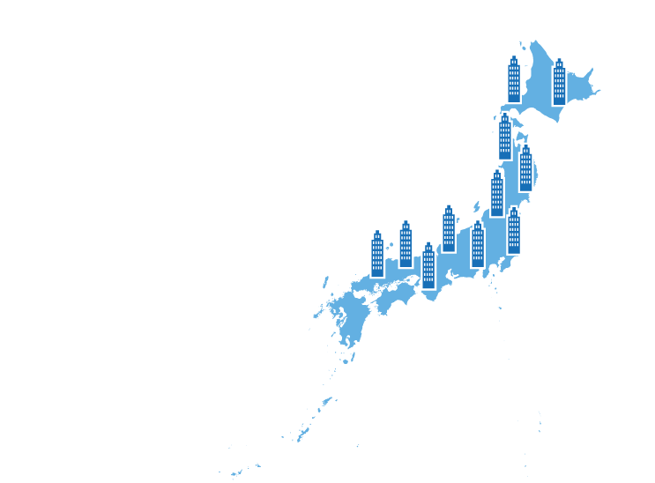
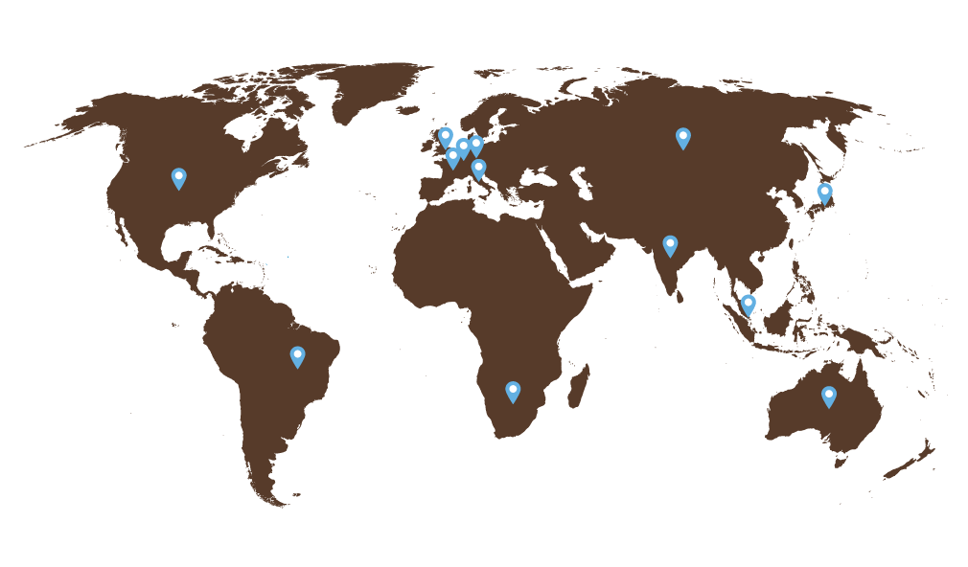
Over 1,500
organizations do <IR>
83%
of CEOs, CFOs and other C-suite executives believe that adopting <IR>
would help deliver success
to their organizations
2,000 participating in <IR> Networks worldwide
Over 300 companies have adopted <IR> in Japan
Notes:
Over 1,500 organisations are now doing some form of Integrated Reporting.
83% of CEOs, CFOs and other C-suite executives believe that adopting <IR> would help deliver success to their organizations. This is according to a recent survey of 400 leaders by CIMA, AICPA and Black Sun. (http://integratedreporting.org/wp-content/uploads/2016/12/2016-Value-of-Value-Board-Level-Insights-1.pdf)
2,000 participating in <IR> Networks worldwide
Over 300 businesses in Japan have adopted integrated reporting, according to Japanese government sources.

Slide 31
<IR> Benefits
Investors
Markets and Society
Business
Notes:
<IR> Benefits to Business
Breakthroughs in understanding value creation
Improving what is measured
Improving management information and decision making
A new approach to stakeholder relations
Connecting departments and broadening perspectives
Benefits to Investors
Wider information on capitals for relevant investment decisions
Greater confidence in the management of companies
improved dialogue between investors and management
Benefits to the Market and Society
Align capital allocation and corporate behaviour through integrated reporting and thinking to wider goals of financial stability and sustainable development

Slide 32
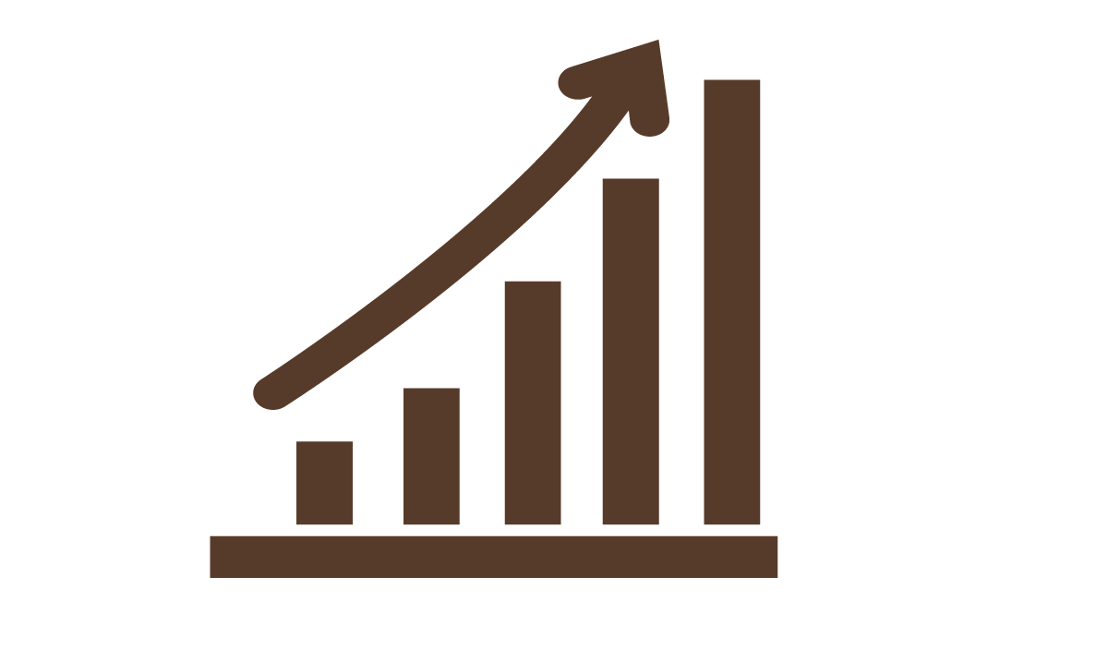



Of SA Non-Executive Directors believe
integrated thinking increases the quality
of organisations’ dialogue with shareholders
and other stakeholders
79%
Of participants
see increased understanding
of value creation
92%
87%
80%
<IR> participants believe investors
better understood their strategy
Of investors believe
quality of reporting affect professional perception
of management quality
Notes:
[http://integratedreporting.org/resource/saica-integrated-thinking-an-exploratory-survey (2015)]
79% of non-executive directors surveyed in South Africa by SAICA believe integrated thinking has increased the quality of organisations’ dialogue with providers of financial capital and other stakeholders
[http://integratedreporting.org/wp-content/uploads/2014/09/IIRC.Black_.Sun_.Research.IR_.Impact.Single.pages.18.9.14.pdf]
92% of respondents to a Black Sun survey see increased understanding of value creation as a current benefit
87% of IIRC Pilot Programme participants that publish an integrated report believe investors better understood their strategy.
[https://www.pwc.com/gx/en/audit-services/corporate-reporting/publications/investor-view/assets/pwc-investors-survey-powerful-stories-through-integrated-reporting.pdf ]
According to 80% of investors in a global survey conducted by PwC, investment professionals' perception of management quality is affected by the quality of a company's reporting. And nearly two-thirds of investment professionals said that the quality of a company's reporting could have a direct financial impact on its cost of capital.

Slide 33
Getting Started
Notes:
There are a number of sources you can turn to find out more and to get started on your <IR> journey. As well as quite a lot of literature on various other bodies websites (like the Starters Guide at http://integratedreportingsa.org), the IIRC runs several Networks and has several resources available to help.

Slide 34
<IR> Networks
The Business Network
Public sector
Pension funds
Technology
Banking
Accountancy bodies
Academics
Insurance
Investors
Notes:
Around 2000 people are participating in a range of networks around the world to continue their journey towards <IR>. Participants in these networks are leading the way in adopting <IR> with transformational effects not just on the way they report, but on the way they think and act.
<IR> networks are instrumental in increasing the pace and scale of <IR>, primarily through the <IR> Business Network the IIRC’s flagship programme, for businesses committed to the adoption of <IR>.
Details on each of these Networks is at http://integratedreporting.org/ir-networks/

Slide 35
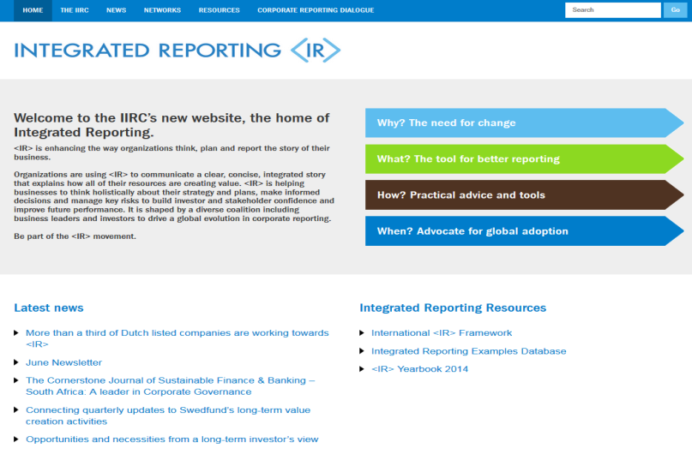
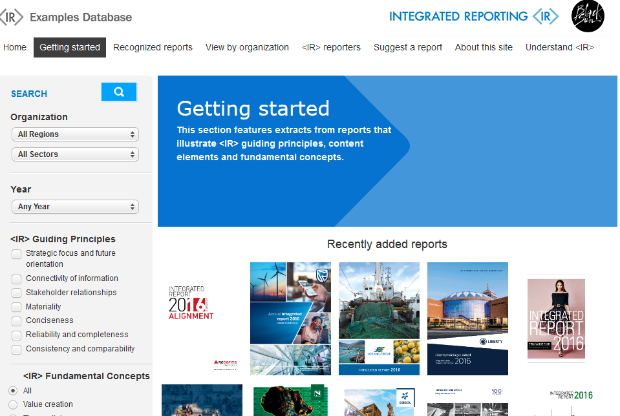
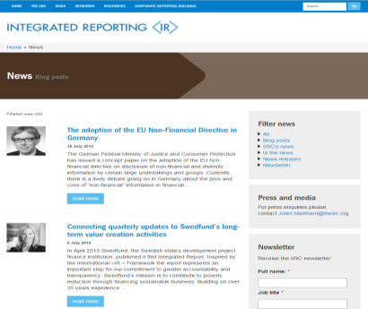
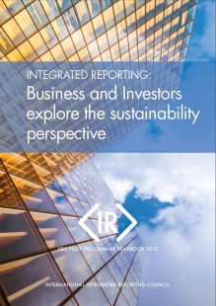
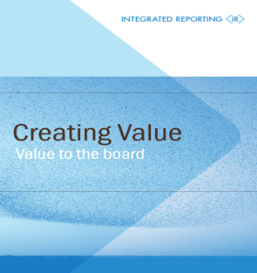
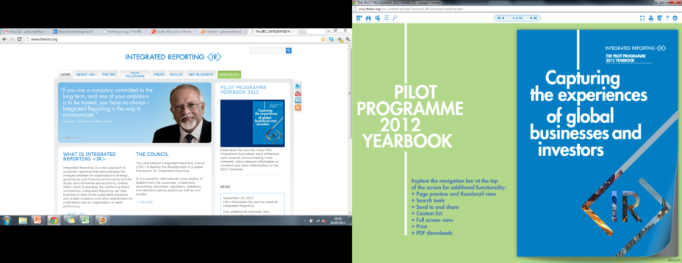
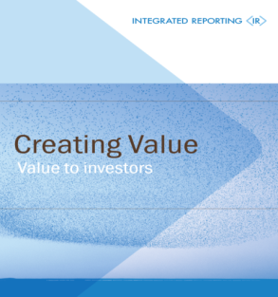
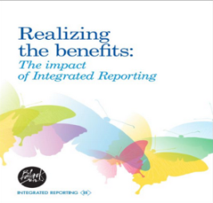
Resources
www.integratedreporting.org
examples.integratedreporting.org
Blogs, news and newsletters
Yearbooks, guidance, surveys
Creating Value series
Notes:
The IIRC has the many resources on its website http://integratedreporting.org. This slide shows a selection of them.
Also the Emerging <IR> Database at examples.integratedreporting.org is a great tool that demonstrates different ways the Guiding Principles and Content Elements of <IR> are beginning to be applied.
A new database of academic articles will also soon be launched.

