Slide 1
These slides are shared with members of the Integrated Reporting PAO Network with limited design elements so that you can add your organization’s branding/template.
Please contact Laura Leka (lauraleka@ifac.org) if you would like to include the IFAC and/or IIRC logo(s).

Slide 2
<IR> and investor benefits

Slide 3
What are investors asking for?

Slide 4
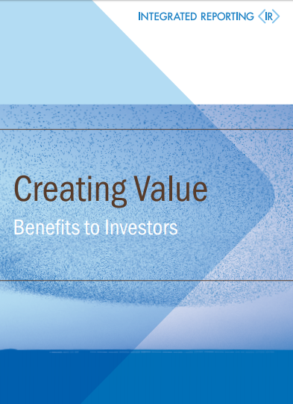
Investors have signaled that important information:
focuses on measurable factors such as cost and risk or explains how the business model works
clearly explains the links between the organization’s environmental, social activities and similar intangible investments and expectations of future performance or risk
allows comparisons to be made between companies in the same sector
sets out sustainable competitive advantages.
Notes:
Source: IIRC: Creating Value Benefits to Investors (2017)
http://integratedreporting.org/wp-content/uploads/2017/11/CreatingValue_Benefits_to_InvestorsIIRC.pdf

Slide 5
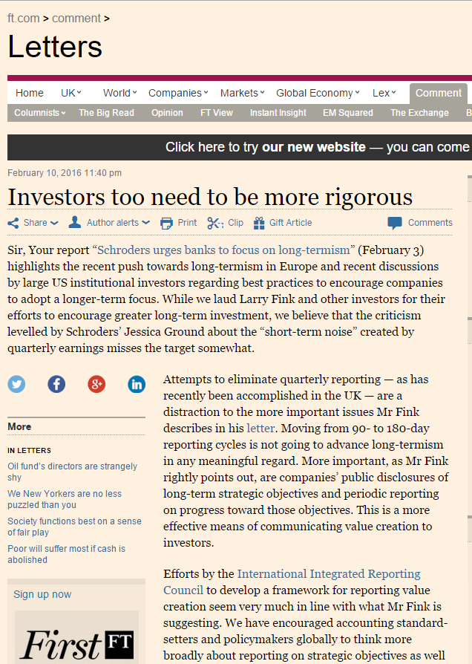
“We are asking that every CEO lay out for shareholders each year a strategic framework for long-term value creation. Additionally, because boards have a critical role to play in strategic planning, we believe CEOs should explicitly affirm that their boards have reviewed those plans. BlackRock’s corporate governance team, in their engagement with companies, will be looking for this framework and board review.”
Larry Fink, CEO, BlackRock
"Efforts by the International Integrated Reporting Council to develop a framework for reporting value creation seem very much in-line with what Mr Fink is suggesting."
Sandra Peters, Head of Global Financial Reporting Policy, CFA Institute
Notes:
Investors are now saying that they need more than financial information in order to make informed investment decisions.
On February 1, 2016 Larry Fink, CEO of the world’s largest asset manager, BlackRock wrote to the Chief Executives of S&P 500 companies and large European organizations, setting out a vision to overcome short-termism and urging greater transparency over longer term strategy and growth plans. In the letter he says:
“We are asking that every CEO lay out for shareholders each year a strategic framework for long-term value creation. Additionally, because boards have a critical role to play in strategic planning, we believe CEOs should explicitly affirm that their boards have reviewed those plans. BlackRock’s corporate governance team, in their engagement with companies, will be looking for this framework and board review.”
The primary purpose of an integrated report is to improve the quality of information available to providers of financial capital by communicating broader and more relevant information that can assist in effective capital allocation decisions. And as Larry Fink says in his letter, “one reason for investors’ short-term horizons is that companies have not sufficiently educated them about the ecosystems they are operating in, what their competitive threats are and how technology and other innovations are impacting their businesses.”
[You can read the full letter here: https://www.blackrock.com/corporate/en-no/literature/press-release/2016-larry-fink-ceo-letter.pdf]
This powerful call for change is a perfect example of what the IIRC is trying to achieve through the global introduction of Integrated Reporting.
Commenting on the letter, Sandra Peters, Head of Global Financial Reporting Policy, CFA Institute said, “Efforts by the International Integrated Reporting Council to develop a framework for reporting value creation seem very much in-line with what Mr Fink is suggesting.”
[Taken from the FT article: https://www.ft.com/content/bde4e2ec-cc07-11e5-be0b-b7ece4e953a0)]

Slide 6
EY have found that
92%
of over 320 investors surveyed agree or strongly agree with the statement that: “Public company CEOs should lay out an explicit strategy each year for long-term value creation and directly affirm that the company’s board has agreed it.”
Notes:
EY’s 2017 annual investor survey found that 92% of over 320 investors surveyed supported Larry Fink’s call for companies to report on strategy for long term value creation and agreed or strongly agreed with the statement that:
“Public company CEOs should lay out an explicit strategy each year for long-term value creation and directly affirm that the company’s board has agreed it.”
EY report: “Is your non-financial performance revealing the true value of your business to investors?”
(http://www.ey.com/Publication/vwLUAssets/EY_-_Nonfinancial_performance_may_influence_investors/$FILE/ey-nonfinancial-performance-may-influence-investors.pdf

Slide 7
And PWC found that
63%
of investment professionals agree or agree strongly that business success in the 21st century will be defined by more than financial profit.
Notes:
PwC’s 2016 Global Investor Survey of 438 investment professionals in 18 countries found that 63% agree or strongly agree that business success in the 21st century will be defined by more than financial profit.
Full survey here: https://www.pwc.com/gx/en/ceo-survey/assets/2016-global-investor-survey.pdf

Slide 8
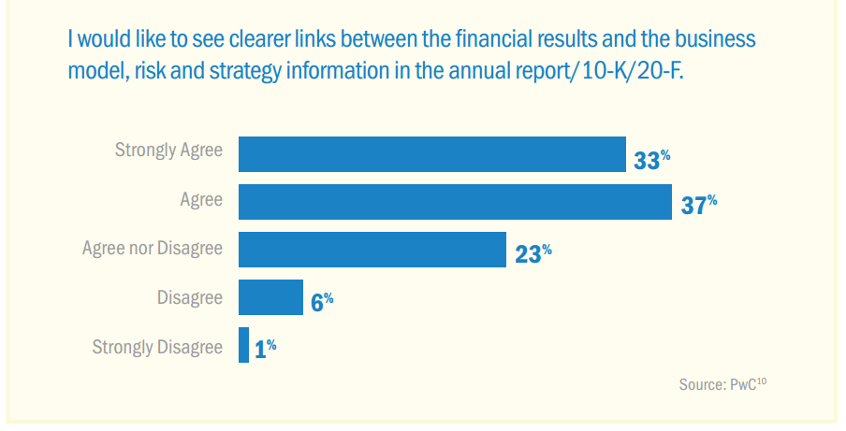
Notes:
Interviews conducted by PwC in 2014 with 85 investment professionals from around the world seeking their views on financial reporting show that 70% of investors would like to see clearer links between the financial results and the business model, risk and strategy information in the annual report/10-K/20-F
[Full report: Corporate performance: What do investors want to know? Innovate your way to clearer financial reporting, PwC, 2014
https://www.pwc.com/gx/en/audit-services/corporate-reporting/publications/investor-view/assets/pwc-investor-survey-ir-september2014.pdf]

Slide 9
Investors told PwC that:
“Integrated ESG information allows them to assess a host of important variables including whether to invest, divest, engage or look closer to see if there are other problems in the business. But, crucially, they also said that there are gaps in the ESG information companies report and that often it isn’t very well integrated into corporate communications. While acknowledging that ESG information is a fast-developing aspect of valuation, they all argued for improved data, more connectivity and consistently applied frameworks.”
Notes:
PwC report: “It’s not just about the financials The widening variety of factors used in investment decision making”, (2016)
http://integratedreporting.org/wp-content/uploads/2016/08/Its-not-just-about-the-financials_the-widening-variety-of-factors-used-in-investment-decision-making_FINAL.pdf

Slide 10
Investor benefits of Integrated Reporting

Slide 11
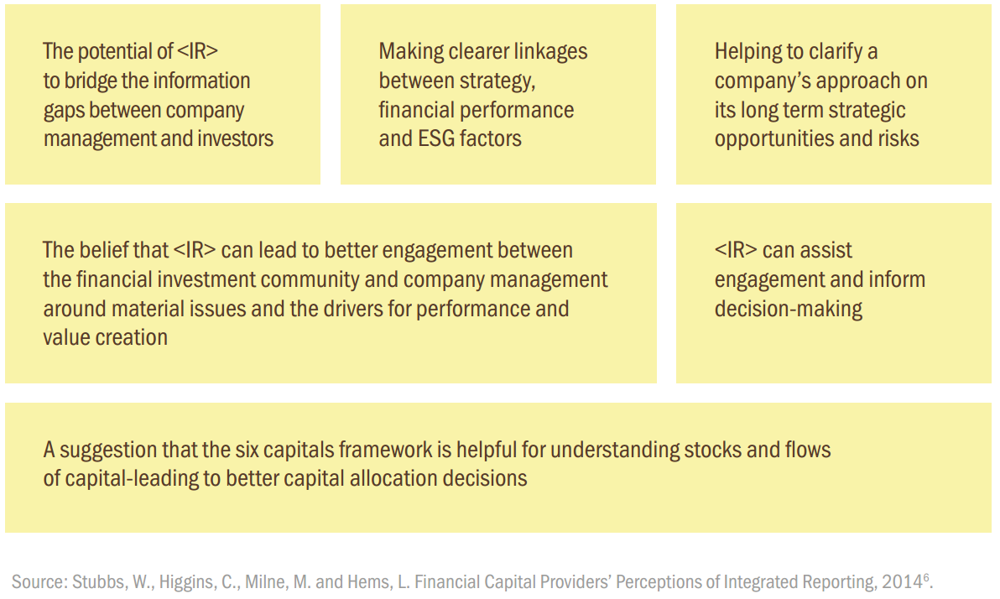
Notes:
Research encompassing a small group of Australian providers of financial capital about the significance of integrated reporting and the six capitals to investment decisions and the functioning of the market, found that the participants believe there are benefits for both the companies producing reports and the investment community.
This slide shows the highlights from this research.

Slide 12
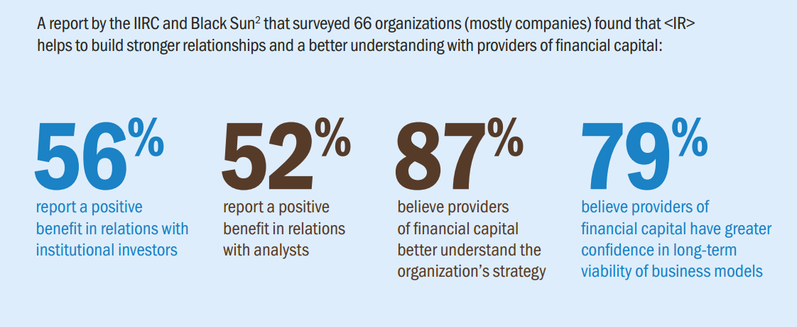
Realizing the Benefits: The Impacts of Integrated Reporting (2014)
Notes:
In 2014, BlackSun surveyed 66 organizations (mostly companies) to understand lessons learned from their experiences implementing integrated reporting. Their findings are summarized in the report “Realizing the Benefits: The Impacts of Integrated Reporting (2014)”: [http://integratedreporting.org/wp-content/uploads/2014/09/IIRC.Black_.Sun_.Research.IR_.Impact.Single.pages.18.9.14.pdf ]
Of those organizations that had published at least one report, they found that Integrated Reporting helped to build stronger relationships and better understanding with providers of financial capital:
56% report a positive benefit in relations with institutional investors
52% report a positive in relations with analysts
87% believe providers of financial capital better understand the organization’s strategy
79% believe providers of financial capital have greater confidence in long-term viability of business models

Slide 13
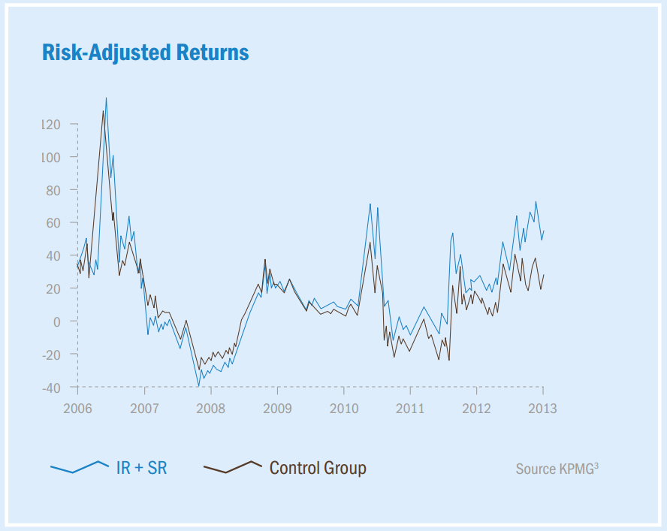
Companies that disclose more than just financial information started outperforming their control group in mid 2010.
Source: KPMG
Notes:
Towards Better Business Reporting (2015): A study by KPMG and National University of Singapore applied the underlying concepts of the International <IR> Framework to a group of 80 firms in the Asia Pacific.
This study found that companies that disclose more than just financial information, started outperforming their control group in mid 2010, at around the same time as the introduction of <IR>

Slide 14
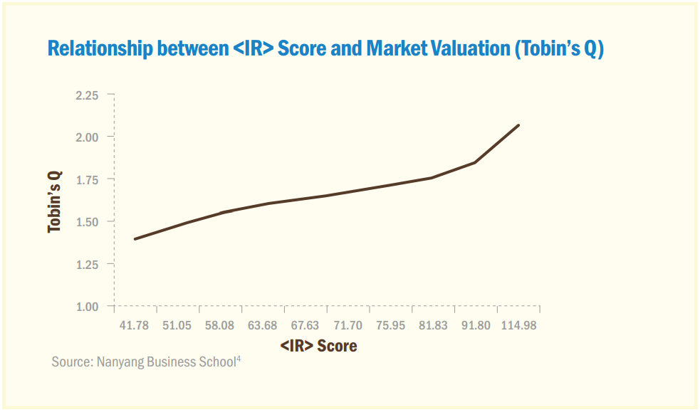
Notes:
http://integratedreporting.org/wp-content/uploads/2014/04/Integrated-Reporting-and-corporate-valuation-Media-28-April-2014_NTU.pdf
Similarly, a Nanyang Business School study looks at the association between <IR> and company valuation.
A score was constructed based on the level of disclosure of and the market valuation of equity by investors was also measured.
Findings show that firms with a higher score have a higher market valuation.

Slide 15
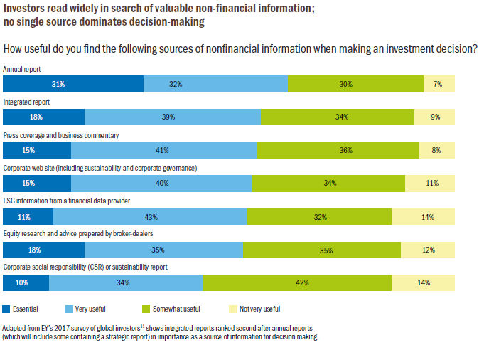
Notes:
EY’s 2017 global survey found that in terms of usefulness of sources of non-financial information when making an investment decision, integrated reports were rated second only to annual reports (some of which are integrated or, in the case of the UK, follow the Strategic Report guidance which is well aligned with the <IR> Framework).
[Full results of EY’s 2017 global survey of more than 320 investors are published in the report “Is your non-financial performance revealing the true value of your business to investors?” http://www.ey.com/Publication/vwLUAssets/EY_-_Nonfinancial_performance_may_influence_investors/$FILE/ey-nonfinancial-performance-may-influence-investors.pdf ]

Slide 16
In a survey completed by Edelman of 158 investors:
Notes:
Edelman: Qualitative Information Study: It’s NOT Only The Numbers: How Institutional Investors Use Non-Quantitative Information, 2015
https://www.edelman.com/assets/uploads/2015/06/Edelman-FinComm_Value-of-Non-Quantitative-Information.pdf

Slide 17
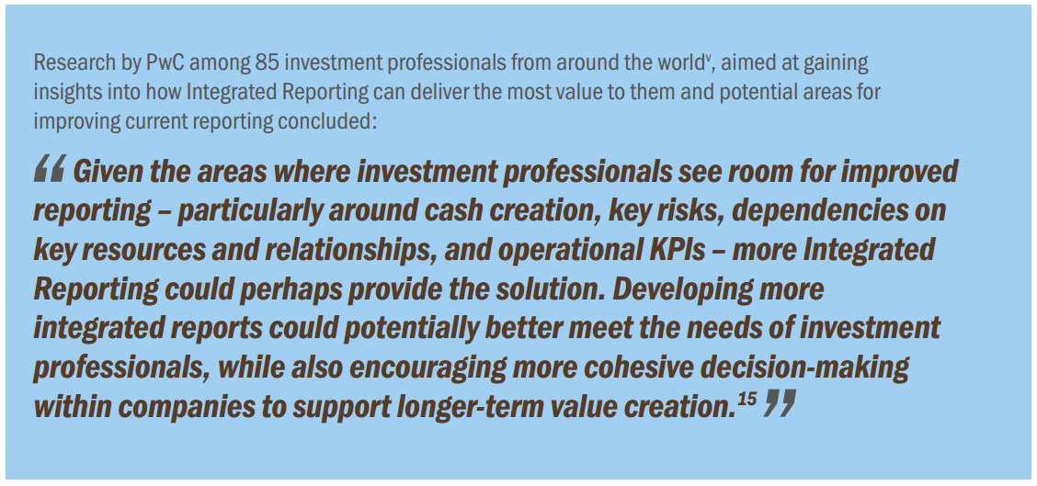
Notes:
https://www.pwc.com/gx/en/audit-services/corporate-reporting/publications/investor-view/assets/pwc-investors-survey-powerful-stories-through-integrated-reporting.pdf
Corporate performance: What do investors want to know? Powerful stories through integrated reporting, PwC, 2014

