Slide 1
These slides are shared with members of the Integrated Reporting PAO Network with limited design elements so that you can add your organization’s branding/template.
Please contact Laura Leka (lauraleka@ifac.org) if you would like to include the IFAC and/or IIRC logo(s).

Slide 2
Creating Value with Integrated Thinking and Reporting, and The Role of Finance Professionals

Slide 3
From Integrated Thinking to Reporting – Reporting on What Matters
Integrated reporting is a process founded on integrated thinking that results in a periodic integrated report by an organization about value creation over time and related communications regarding aspects of value creation
Integrated reporting is more than a reporting framework helping organizations:
Create value by better understanding and connecting drivers of value, and
Telling the story – of how value is created
Notes:
Integrated reporting seeks to change the way businesses think about creating and sustaining value. Integrated reporting is designed to change corporate behavior through the evolution of integrated thinking.
Integrated thinking is therefore a necessary part of integrated reporting for it to achieve its aims and to benefit organizations through improved decision making. Integrated reporting is iterative - the process/discipline of an integrated reporting will improve integrated thinking, which should translate to better reporting, which will in turn improve the thinking. Integrated thinking leads to integrated decision-making and actions that consider the creation of value over the short, medium and long term. Assembling an integrated report is designed to enable integrated thinking.
The Integrated reporting process involves
Developing a broader, and deeper longer term understanding of how an organization creates value in the context of the external environment, strategy, business model and capitals, and risks and opportunities. Integrated reporting therefore should be used as a key management tool to improve performance.
Improving communications, both internally and externally, about how value is created and sustained. As a strategic means of communication on those aspects that matter to value creation, integrated reporting should not be a reporting burden.
The development of an integrated report that clearly and concisely communicates value creation is guided by the International Integrated Reporting Framework (2013). It is important not to treat an integrated report as simply an aggregate or combination of existing reports.

Slide 4
What is Integrated Thinking?
“Integrated thinking is the active consideration by an organization of the relationships between its various operating and functional units and the capitals that the organization uses or affects.”
-The International <IR> Framework, IIRC, December 2013
Takes into account the connectivity and interdependencies between the range of factors that affect an organization’s ability to create value over time
Enhances the connectivity of information flow into management reporting, analysis and decision-making
Notes:
Integrated thinking involves understanding the connections between the capitals or resources, relationships, and different approaches to creating value for the organization and its stakeholders through changes to business models.
It is implemented by integrated strategy, planning and decision making requiring an understanding of the significant opportunities and risks related to the value creation process and different types of capital. This level of integration and understanding depends on connecting people, functions, information (financial and operational, internal and external), and systems.
Integrated thinking should result in increased organizational alignment between strategic objectives and value creation in the context of the changing business environment taking into account the interdependencies between a range of factors that affect an organization’s ability to create value. The result is greater confidence in making value creating decisions for the short, medium, and long term based on relevant quality information and analysis and robust and connected internal processes.
Integrated thinking helps break down silos revealing connections between what individuals and functions do and the consequences for the organization as a whole. Connectivity throughout the organization and a convergence of different mindsets, expertise and professional backgrounds will help enhance the connectivity of information flow supporting internal and external reporting.
For many organizations, integrated thinking involves greater systems thinking and enabling greater connectivity in various dimensions including
Financial and “non-financial” information
Past, present and future
Quantitative and qualitative information
Information used by management, board and externally reported
The integrated report, and other communications.

Slide 5
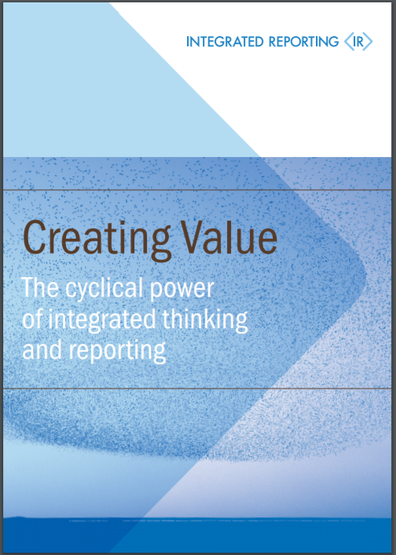
The Cyclical Power of Integrated Thinking and Reporting
Integrated reporting is an outcome of integrated thinking
Both are necessary to enhance connectivity in the organization and enhance communication on value creation. In combination they
Improve understanding of strategy and how value is created throughout the organization with fewer silos based on a multi-capitals approach
Enable a cohesive management information and informed decision making, enhancing accountability and performance
https://integratedreporting.org/resource/creating-value-the-cyclical-power-of-integrated-thinking-and-reporting/
Notes:
Integrated reporting should be the outcome of an internal integrated thinking process at board and management level.
Integrated thinking is key to successful integrated reporting and both are necessary to enhance connectivity in the organization and enhance understanding of and communication on drivers of value creation. Integrated reporting is iterative - the process/discipline of an integrated reporting will improve integrated thinking, which will come through in a better report next time, which will in turn improve the thinking.
According to the IIRC’s publication, Creating Value, The Cyclical Power of integrated thinking and reporting, in combination they help
Improve understanding of strategy and how value is created throughout the organization with fewer silos based on a multicapitals approach
Enable a cohesive management information and informed decision making, enhancing accountability and performance.
Integrated thinking enables connectivity of information helping board and management to make important connections internally, and users to make important connections externally.

Slide 6
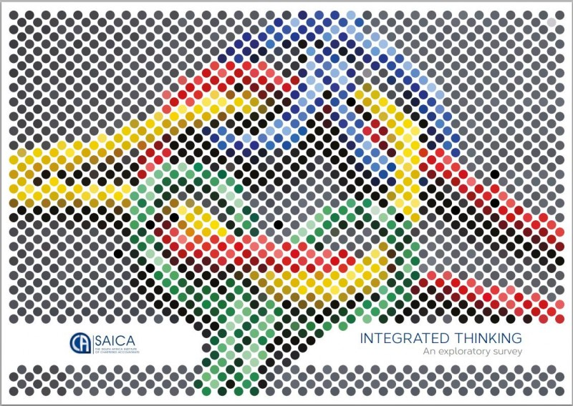
SAICA - Integrated Thinking, An Exploratory Survey (2015)
Key findings:
78% (Executives) and 71% (NEDs) say <IR> has driven integrated thinking
74% (Executives) and 93% (NEDs) say integrated thinking has improved decision-making at management level
72% (Executives) and 86% (NEDs) say integrated thinking has improved decision-making at board level
68% (Executives) and 71% (NEDs) say integrated thinking helped develop a more cohesive approach to reporting
Notes:
http://integratedreporting.org/resource/saica-integrated-thinking-an-exploratory-survey (2015)
The South African Institute of Chartered Accountants (SAICA) published, ‘Integrated thinking, an exploratory survey‘ in which they reveal the results of the top 100 companies listed on the Johannesburg Stock Exchange and leading state-owned entities (all of which undertake integrated reporting).
Key findings include:
78% (Executives) and 71% (NEDs) say <IR> has driven integrated thinking
74% (Executives) and 93% (NEDs) say integrated thinking has improved decision-making at management level
72% (Executives) and 86% (NEDs) say integrated thinking has improved decision-making at board level
68% (Executives) and 71% (NEDs) say integrated thinking helped develop a more cohesive approach to reporting
Other
74% (Executives) and 79% (NEDs) say integrated thinking increased quality of dialogue with providers of financial capital and other stakeholders
68% (Executives) and 62% (NEDs) say integrated thinking lead to other benefits
32% (Executives) and 100% (NEDs) fully embraced integrated thinking
68% (Executives) partially embraced integrated thinking

Slide 7
ACCA findings or other findings?

Slide 8
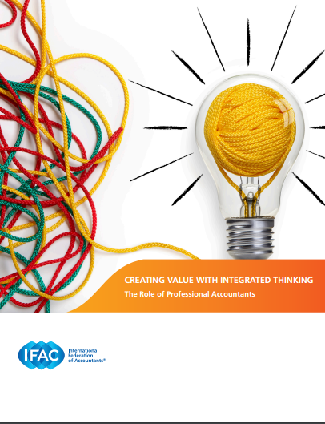
The Role of Finance Professionals
IFAC publication on Creating Value with Integrated Thinking:
Vision and Framework for Integrated Thinking
Specifically explores contribution of finance professionals
https://www.ifac.org/publications-resources/creating-value-integrated-thinking
Notes:
IFAC developed the thought paper, Creating Value with Integrated Thinking, The Role of the Professional Accountant, to help facilitate the contribution of professional accountants and finance professionals to integrated thinking. It sets out a vision for integrated thinking and explores what professional accountants working in the public and private sectors can do in practical terms to facilitate it in their organization, regardless of whether their organization is planning to publish an integrated report. It identifies five key elements, which, if implemented, can lead to more effective organizations. This ultimately provides the basis for shifting from today’s financially oriented reporting to integrated reporting.

Slide 9
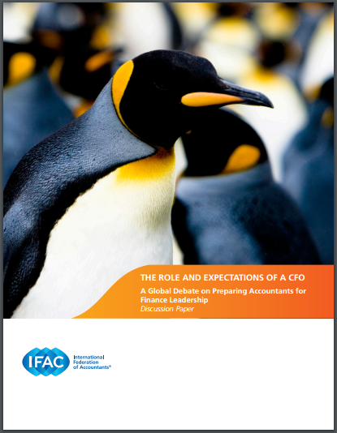
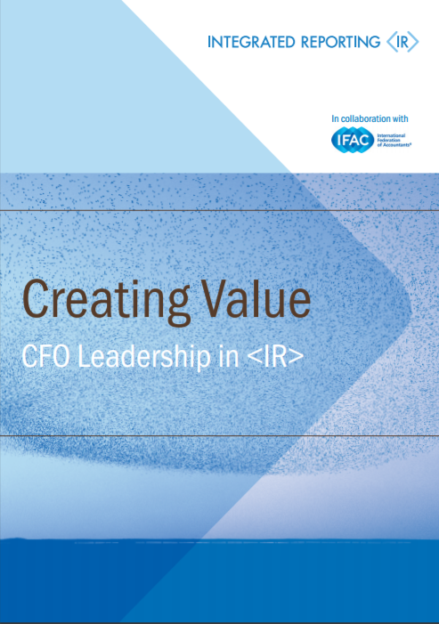
Integrated Thinking and the Business Partner Agenda
Integrated thinking aligns to, and enables, the business partner agenda
Ensures a focus on the information and decisions that matter to the organization, value creation, and its potential success
Enhances the relevance of finance professionals
Notes:
As CFOs and finance leaders increasingly evolve into business partners and organizational integrators and navigators, as outlined in IFAC’s The Role and Expectations of a CFO: A Global Debate on Preparing Accountants for Financial Leadership (https://www.ifac.org/publications-resources/role-and-expectations-cfo-global-debate-preparing-accountants-finance-leaders), integrated reporting falls under their purview. Integrated thinking and reporting provides a way and additional incentive for CFOs, and their finance teams, to focus on the information and decisions that matter to the organization and its potential success. For finance teams that have begun to shift toward business partnership with all areas of their organization, the principles and concepts of integrated thinking and reporting are a natural progression on their journey.
Ultimately integrated thinking and reporting will enhance the relevance of finance professionals in their organizations.
Creating Value – CFO Leadership in <IR> published by the International Integrated Reporting Council, in collaboration with IFAC, also looks at how integrated reporting and thinking fits logically with the evolving role of the CFO and suggests key actions CFOs can consider to successfully achieve integrated reporting in their organizations.

Slide 10
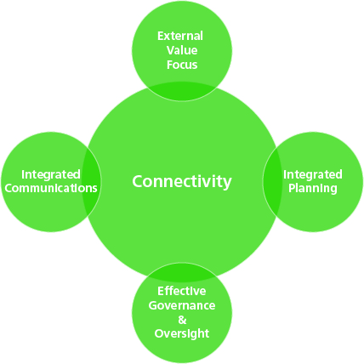
The Contribution of Finance Professionals
Finance professionals can have an impact by:
Fostering an external value focus
Integrated planning
Supporting effective governance and oversight
Engaging in integrated communications
Notes:
The contribution of finance professionals to integrated thinking covers 4 main areas based on enhancing connectivity - A connected approach supports
an external value focus
integrated planning
effective governance and oversight
and integrated communications.
Integrated thinking depends on greater connectivity throughout the organization. With their broader view of an organization, the CFO and the finance function can begin to ensure that all aspects involving people, processes, and systems are better connected. Greater connectivity between management and reporting processes, and between different organizational functions, involves developing an integrated planning approach that brings together people with different expertise and professional backgrounds, and with different perspectives of the organization. CFOs and the finance function are well positioned to make important connections between different elements of planning, including better understanding and management of uncertainty and risk, and the links to strategic planning and operational and financial performance.

Slide 11
1. Fostering an External Value Focus
Finance professionals have an impact if they:
Analyze mega trends in the business environment;
Understand the impact of their organization on society;
Are aware of what will impact public perception and their reputation;
Understand the providers of financial capital and other stakeholders; and
Incorporate these into the organization’s management/reporting processes
Notes:
An external focus is a critical starting point for identifying and articulating how value is created and destroyed.
Resilient and agile organizations typically have internal processes and information that provide a relentless focus on creating sustainable value in the context of the external environment. Identifying and understanding relevant matters for decision making involves bringing together information and analysis from various sources. To have influence, finance professionals need to
Analyze the impact of mega trends and changes in the business environment;
Understand the impact their products and services have on society and on markets;
Understand what impacts the organization’s reputation and public perception, and the overall customer experience;
Understand and assimilate the perspectives of providers of financial capital and other stakeholders; and
Incorporate all of these into the organization’s management processes.

Slide 12
2. Integrated Planning
Finance professionals have an impact if they:
Build awareness of how the capitals are relevant by integrating them into planning processes including:
Setting goals and targets
Risk management
Budgeting and project appraisal
Performance management and aligning performance to objectives
Presenting this information in a clear way (e.g., by dashboard) and analyzing it helps managers to make effective decisions
Notes:
The insights gained from an external value focus form the basis of integrated planning, which should incorporate a comprehensive process of identifying and managing significant matters affecting value creation over the short, medium, and long term. Integrated planning allows the board and senior and other management to be aware of the significant risks and opportunities the organization needs to manage proactively as part of their decision making. Ultimately, relevant matters potentially impacting value need to be built into setting organizational objectives and targets, managing risk and opportunity, undertaking project and investment appraisals, aligning performance to objectives with relevant performance measures, and information collection systems and key metrics for internal processes.
To have impact, finance professionals need to:
Build awareness of how the capitals are relevant by integrating them into planning processes. Finance professionals will need to help to define and connect how the six capitals are relevant to the organization and the multiple and complex connections between them. Integrating relevant and material matters throughout the planning and management process involves an integrated approach to:
Setting goals and targets
Risk management
Budgeting and project appraisal
Performance management and aligning performance to objectives.

Slide 13
3. Supporting Effective Governance and Oversight
Finance professionals have an impact if they:
Support boards and management to commit to integrated thinking and reporting
Support audit committees to oversee the reporting process and help to manage the associated risk
Notes:
Appropriate governance and oversight structures ensure effective processes and accountabilities for all organizational initiatives and ultimately lead to better performance. External stakeholders will increasingly demand integrated business reports as evidence of management strength and integrated thinking.
Finance professionals are well placed to influence and facilitate board and management commitment to integrated thinking and reporting highlighting the benefits for both the organization and its stakeholders, and ensuring appropriate levels of understanding and accountability. Strong governance and leadership from the top of the organization is necessary to ensure integrated reporting leads to effective communication on the full range of issues impacting value creation.
They can also support the audit committee’s significant role in overseeing the reporting process and related risk. For financial professionals, this involves maintaining effective processes and accountabilities across all forms of reporting and disclosure to financial capital providers and others. By establishing and maintaining effective risk management and internal control over all relevant reporting processes and systems and beginning to expand into the wider range of data and issues encompassed by the International Framework, the audit committee can also ensure that all organizational information moves toward the highest level of quality.

Slide 14
4. Engaging in Integrated Communications
Finance professionals have an impact if they:
Enable better disclosure connected to internal reporting and decision making rather than more disclosure
Enable communication on the full range of issues impacting value creation across the six capitals
Ensuring integrated communications extends to regulated reporting and disclosures, and management commentary
Notes:
Integrated communications requires a shift from a financial focus to reporting on progress in relation to all relevant capitals aligned to organizational goals and objectives. The aim is to achieve more effective internal and external disclosure rather than more reporting and disclosure.
The capitals should be reinforced in the performance management cycle and where material included within financial and regulated reports as well as the annual report and management commentary providing context for financial statements and operational performance.
Ultimately integrated communications will demonstrate an organization’s capacity for integrated thinking to investors, creditors, and other stakeholders.

Slide 15
What should finance professionals be doing to support integrated thinking?
Promote awareness of the benefits and challenges
Develop relevant processes and systems, for integrated decision making
Lead on integrating additional capitals into performance management and reporting
Work with other parts of the organization to ensure non-financial data is of adequate quality
Notes:
The CFO and finance function can
Promote awareness of the benefits of integrated thinking and reporting across the organization, including what aspects of existing practices are already integrated. A candid dialogue on the challenges is also beneficial so changes needed are fully understood
Develop relevant processes and systems, and metrics for integrated decision making
Lead on integrating additional capitals into performance management and reporting where there are gaps In understanding and managing drivers of value creation. Help assess what data is required to support understanding and decisions making, and current levels of data governance and maturity
Work with other parts of the organization to ensure non-financial data is of adequate quality for decision making purposes.

Slide 16
Considerations for PAOs
How can we continue to support the profession’s contribution to integrated thinking and reporting? Key questions include
How to embed integrated thinking in education and member development?
How to promote integrated thinking and the role of the accountants?
With whom to build partnerships to advance integrated thinking?
Please send ideas for topics related to integrated thinking to cover at <IR> PAO Network webinars to lauraleka@ifac.org and stathisgould@ifac.org

