Slide 1
Introduction
Notes:
This module is designed to provide an introduction to the IPSASB and to the IPSAS.
If participants are already aware of the IPSASB, consider whether this module can be omitted, or the content reduced.
If participants have no awareness of accrual accounting, consider whether any additional information will need to be included; for example, background on private sector accounting under IFRS, GFS reporting, etc.

Slide 2
The Handbook of International Public Sector Accounting Pronouncements is the primary authoritative source of international generally accepted accounting principles for public sector entities.
All information in this presentation is proprietary and copyrighted.
Introduction

Slide 3
Structure of Course
Based on accrual IPSAS in the IPSASB Handbook
Series of independent modules
Illustrative examples and case studies
Self assessment quiz
Introduction

Slide 4
Who is the IPSASB?
Independent standard-setting board
18 members; international composition; meetings and materials public
Objective: Strengthening public financial management (PFM) globally through increasing adoption of accrual-based IPSAS:
Delivered through two main areas of activity, both of which have a public interest focus:
Developing and maintaining IPSAS and other high-quality financial reporting guidance for the public sector; and
Raising awareness of IPSAS and the benefits of their adoption.
Introduction
Notes:
Note that all the IPSASB agenda papers, minutes, etc. are available on the IPSASB website (https://www.ipsasb.org) along with audio highlights of the meetings.

Slide 5
What are IPSAS?
Authoritative standards for preparation of general purpose financial statements
Designed to apply to public sector entities that
are responsible for the delivery of services to benefit the public and/or to redistribute income and wealth;
mainly finance their activities, directly or indirectly, by means of taxes and/or transfers from other levels of government, social contributions, debt or fees; and
do not have a primary objective to make profits.
Introduction
Notes:
IPSAS has been developed to apply to the public sector entities that do not have a primary objective to make profits.
However, up to each jurisdiction to specify which entities apply IPSAS.
One common approach is for state-owned commercial enterprises to apply IFRS ,with the remainder of the public sector applying IPSAS. However, this is a decision for each country to make. Factors to consider in coming to this decision include:
Existing accounting systems
Consolidation issues (although for commercial transactions, the differences between IPSAS and IFRS are limited – once new IFRS had been addressed in IPSAS)
Whether state-owned commercial enterprises need to apply IFRS for which there is no equivalent IPSAS (e.g. income tax, share-based payments, insurance). While these can be applied in an IPSAS environment, if they are prevalent this might suggest IFRS is a better fit.

Slide 6
Aligned with IFRS where Appropriate
IFRS
(Private Sector)
• Technology
• Guidance for public sector
• Issues of the public sector
• Examples from the public sector
IPSAS
(Public Sector)
Introduction
Notes:
Many IPSAS are aligned with IFRS.
The IPSASB will consider new IFRS standards. The first question the IPSASB will consider is whether there are any public sector reasons to adopt a different accounting treatment. This can lead to a public sector specific IPSAS, or public sector specific requirements in an IPSAS based on an IFRS.
Where there are no public sector reasons to adopt a different accounting treatment, this process is followed in developing an IPSAS based on an IFRS.
Examples of the different approach:
IPSAS 39 Employee Benefits is based on IAS 19, with very minor differences.
IPSAS 40 Public Sector Combinations is a public sector specific IPSAS. While it adopts the same approach to accounting for acquisitions as IFRS 3, it also includes accounting for amalgamations, and guidance on distinguishing between acquisitions and amalgamations. This is because, unlike the private sector, amalgamations are common.

Slide 7
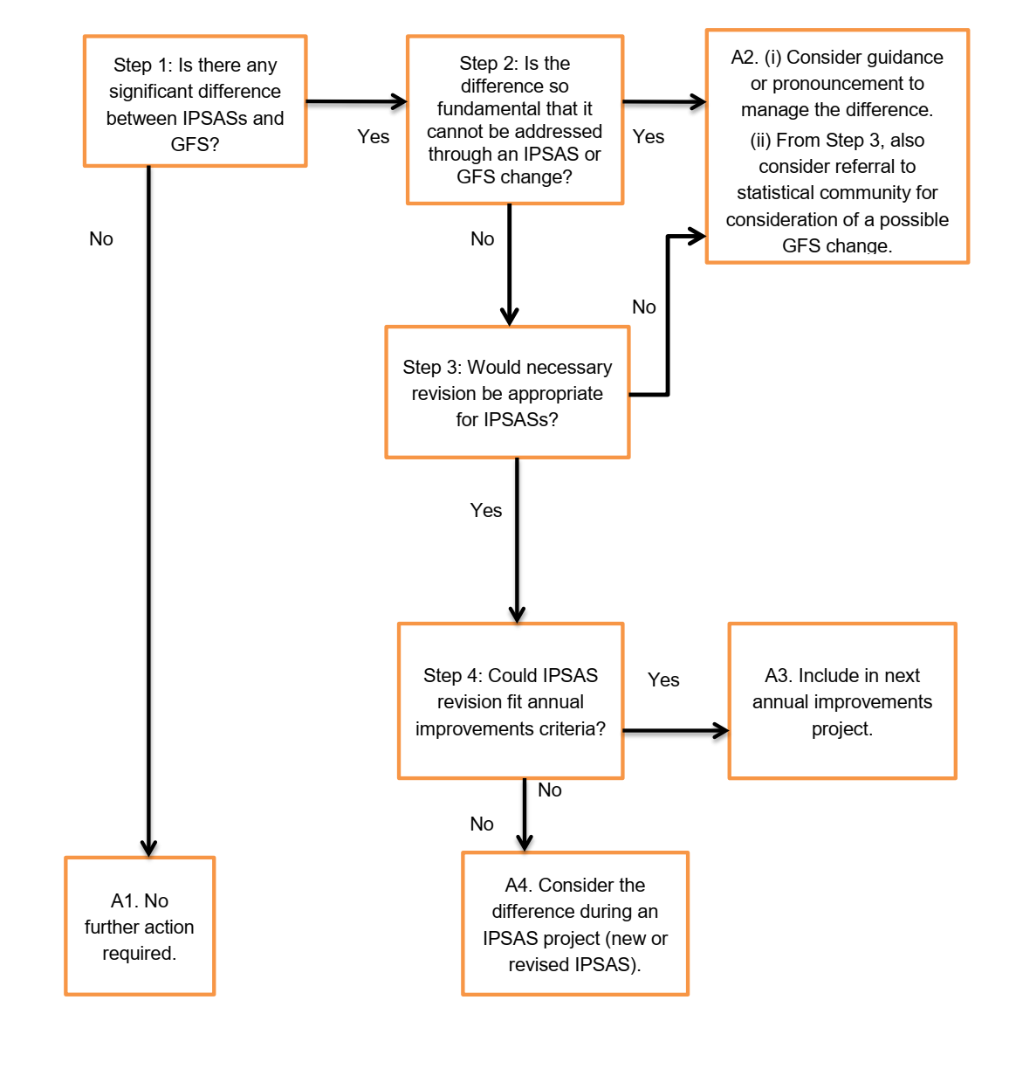
Relationship with GFS
Notes:
For national governments, the macroeconomic statistical reporting framework (System of National Account – SNA – and Government Finance Statistics Manual – GFSM or GFS) are important reporting tools.
Because governments may rely on information produced under both GFS and IPSAS, the IPSASB considers it important to avoid unnecessary differences between the two frameworks. The decision tree on the slide sets out the process the IPSASB follows in deciding how to address differences between IPSAS and GFS. Note that not all differences can be resolved; this is because the two frameworks have different perspectives (IPSAS consider the individual entity, whereas GFS considers the government sector of the economy). Note also that some differences will be referred to the statistical community which may lead to changes in future editions of SNA and GFSM.

Slide 8
More on IPSAS
In addition to authoritative standards (including application guidance) IPSASs include:
Basis for Conclusion
Implementation guidance
Illustrative Examples
Comparison with International Financial Reporting Standards (IFRSs) where applicable
Introduction
Notes:
For those participants who have experience of IFRS, note that the format of IPSAS is similar to that of IFRS (although recent IFRS have moved some aspects of the core standard – such as definitions – to Appendices, an approach not adopted in IPSAS).

Slide 9
IPSAS Due Process
Required
Research – relevant international and national standards and practices
Develop and publish exposure draft – minimum 4 month comment period
Consider responses and amend draft standard as appropriate
Final IPSAS
Public consultation paper may be issued before ED at IPSASB’s discretion
Introduction
Notes:
For participants who are familiar with the IASB due process for IFRS, the IPSASB process is similar. IPSASB Consultation Papers are equivalent to the IASB Discussion Papers.

Slide 10
Different Bases of Accounting
IPSASB defines accounting basis to mean either the accrual or cash basis of accounting as defined in the accrual basis IPSAS or the Cash Basis IPSAS, respectively
Accounting Basis Continuum
Cash Basis
Modified Cash Basis
Modified Accrual Basis
Accrual Basis
Transactions recognized when cash received or paid – reports cash and changes to cash
Transactions recognized as they occur – reports all assets and liabilities
Variations
Introduction
Notes:
Note that only the Cash Basis and the Accrual Basis are defined bases under IPSAS. Modified cash and modified accrual include a range of accounting treatments, and will vary from jurisdiction to jurisdiction. Both include a mixture of items accounted for on a cash basis and items accounted for on an accrual basis. Under the many variations of modified cash and modified accrual, it is important that the readers of the financial statements know how each transaction is accounted for. IPSAS 33 provides guidance on the first time adoption of the accrual basis IPSAS – this is covered in the module on First Time Adoption of Accrual Basis IPSAS.

Slide 11
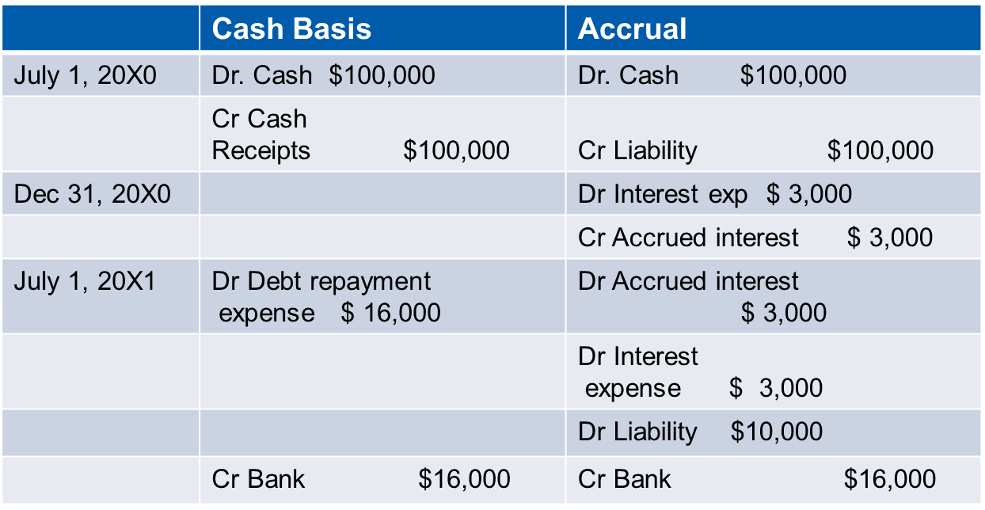
Example of Difference Between Cash and Accrual
$100,000 10-year debenture with coupon rate of 6 % issued July 1, 20x0. Interest and principle payable annually. Fiscal period end is December 31.
Introduction
Notes:
What are the journal entries to record the transactions under a cash and accrual basis of accounting?
For the answer, see the Introduction module (page 13). (Note that in some countries, cash accounting may be single entry – in this case, the Bank entries would be omitted.)

Slide 12
Why adopt the accrual basis?
Reports all
economic resources controlled by entity
claims against economic resources
full cost of goods and services
Improves transparency and accountability
Provides better information for decision making
Improves consistency and comparability of reporting
Introduction
Notes:
Consider adding examples based on the local situation where accrual accounting would provide more transparent treatment than cash accounting.
Possible areas:
Impact of debt rescheduling
Leading and service concession arrangement (PPP) contracts.
Sale of assets at below value.

Slide 13
Transitioning to Accrual Accounting
IPSAS 33 – Exceptions from other IPSAS during transition period
Recognition
Measurement
Presentation
Comparative information
Introduction
Notes:
Details of the accounting requirements that apply when an entity is transitioning to accrual accounting are provided in the First Time Adoption of Accrual Basis IPSAS module.

Slide 14
Features of Successful Transition
A clear mandate;
Political commitment;
Commitment of central entities & key officials;
Adequate resources (human & financial);
An effective project management structure;
Adequate technological capacity and IT systems; and
Use of legislation.
Introduction
Notes:
See IPSASB Study 14 for more details (https://www.ipsasb.org/publications/study-14-transition-accrual-basis-accounting-guidance-governments-and-government-entities-third).
If the participants’ jurisdiction is in the process of transitioning to accrual accounting, discuss these features in the local context.
Note that impact of adoption will, if implemented effectively, be wider than the finance ministry – should provide better information that all decisions makers will need to understand.

Slide 15
Implementation Plan Key Steps
Project initiation;
Detailed project scoping and planning;
Implementation phase; and
Reporting.
Introduction
Notes:
See IPSASB Study 14 for more details (https://www.ipsasb.org/publications/study-14-transition-accrual-basis-accounting-guidance-governments-and-government-entities-third).
If the participants’ jurisdiction is in the process of transitioning to accrual accounting, discuss these key steps in the local context.

Slide 16
Technical Steps to Implementation
Determining the reporting entity
Developing accounting policies
Implementation
Inventory, existing assets, and liabilities
Recognition and measurement
Introduction
Notes:
This course is intended to provide the basic information to begin these tasks.

Slide 17
Identifying the Reporting Entity
Is the entity a reporting entity?
No
Don’t issue GPFS
Yes
Is the entity an economic entity?
No
Issue GPFS applying IPSAS except IPSAS 34
Yes
Controlled Entities:
Departments, agencies and other administrative units
Separate corporate entities
Commercial public sector entities
Required to prepare consolidated GPFS under IPSAS 35?
Prepare separate GPFS under IPSAS 34
No
Yes
Identify components of economic reporting entity
Associates (IPSAS 36)
Joint Ventures
(IPSAS 36)
Joint Arrangements (IPSAS 37)
Introduction
Notes:
These concepts are discussed further in the Consolidation module

Slide 18
Accounting Policies
Specific principles, bases, conventions, rules, and practices
Determined by IPSASs when applicable
Judgment used to select accounting policy when no IPSAS (IPSAS 3)
GAAP hierarchy
IPSASs dealing with similar and related issues
Definitions, recognition and measurement criteria in the Conceptual Framework for General Purpose Financial Reporting by Public Sector Entities
Other standard setting bodies
Accepted practices
Introduction
Notes:
For more details see Presentation module

Slide 19
Application of materiality
IPSAS need not be applied when the effect of applying them is immaterial
An item is material if its omission from or misstatement in the financial statements could influence the discharge of accountability by the entity or the decisions that users make on the basis of the financial statements
The concept of materiality is considered in deciding
Whether items need to be recognized
The application of a particular accounting policy
What items should be disclosed in notes
Introduction
Notes:
Materiality is a key issue for first time adopters.
Knowing which items are material and which are not can reduce the effort required to implement accrual accounting. If participants are not familiar with accrual accounting, they are unlikely to be familiar with materiality. Discuss the concept in light of the local context; if the jurisdiction is implementing accrual accounting for the first time, discuss which items are taking a lot of work, and how material these are.

Slide 20
Questions and Discussion
Visit the IPSASB web site http://www.ipsasb.org
Introduction

