Slide 1
Property, Plant and Equipment
IPSAS® 17
Notes:
IPSAS 17 is based on IAS 16, Property, Plant and Equipment. Participants who are familiar with IAS 16 should be comfortable with IPSAS 17 as long as the key differences are noted.

Slide 2
The Handbook of International Public Sector Accounting Pronouncements is the primary authoritative source of international generally accepted accounting principles for public sector entities.
All information in this presentation is proprietary and copyrighted.
Property, Plant and Equipment

Slide 3
Definition of PP&E
PP&E are tangible items that:
Are held for use in the production or supply of goods or services, for rental to others, or for administrative purposes; and
Are expected to be used during more than one reporting period.
Weapons systems and infrastructure assets meet the definition
Property, Plant and Equipment
Notes:
If participants are not familiar with accrual accounting, an additional slide with examples of PP&E from their jurisdiction could be included here.
Similarly, for entities that are adopting accrual accounting for the first time, identifying PP&E is often one of the most significant tasks. Entities should consider what records could be used to identify those assets. This could be discussed (and a separate slide included if this would be useful) if participants are in the process of implementing accrual IPSAS for the first time.
Examples of records include:
Land registries or similar land ownership registers.
Utility bills (gas/electricity/oil/water/telecoms) can identify buildings where costs are being incurred.
Maintenance contracts can be used to identify assets
Asset registers
Rental income
Records may be incomplete or out of date, and as well as identifying assets to be recognized, might identify costs that are being incurred for assets that the entity no longer controls.

Slide 4
Scope Limitations
Does not apply to:
Biological assets related to agricultural activity (with the exception of bearer plants, which are in the scope of IPSAS 17)
Mineral reserves such as oil, natural gas and similar non-regenerative resources
Does not require, but does not preclude, the recognition of heritage assets
Property, Plant and Equipment
Notes:
Note that IAS 16 does not include any specific provisions regarding heritage assets. If participants are familiar with IAS 16, the heritage provisions should be highlighted.

Slide 5
Recognition Principle
The cost of an item of property, plant, and equipment shall be recognized as an asset if, and only if:
It is probable that future service potential or economic benefits associated with the item will flow to the entity; and
The cost or fair value of the item can be measured reliably.
Property, Plant and Equipment
Notes:
Note that fair value as currently defined in IPSAS is not the same as defined in IFRS 13, Fair Value Measurement. If participants are familiar with IFRS, this difference should be highlighted.
The definition of fair value in IPSAS is:
Fair value is the amount for which an asset could be exchanged, or a liability settled, between knowledgeable, willing parties in an arm’s length transaction.
This includes entry as well as exit values.

Slide 6
Recognition Issues Example
A municipality has spent CU 12 million to install equipment at its water treatment facility to meet new provincial water quality regulations. The equipment has had no effect on the quality and volume of the water treated or the expected life of the treatment plant.
Should the expenditure be capitalized as PP&E? Explain
Property, Plant and Equipment
Notes:
Answer:
The expenditure does not strictly meet the recognition criteria. The equipment required to comply with water quality standards does not provide future economic benefits or service potential. However, it is appropriate to treat the upgrade as PP&E.
Although equipment does not directly embody future economic benefits or service potential, it is necessary for a municipality to obtain future economic benefits or service potential from its water treatment plants.
Items of property, plant, and equipment may be required for safety or environmental reasons. The acquisition of such property, plant, and equipment, although not directly increasing the economic benefits or service potential of any particular existing item of property, plant, and equipment, may be necessary for an entity to obtain the economic benefits or service potential from its other assets. Such items of property, plant, and equipment qualify for recognition as assets.
For example, fire safety regulations may require a hospital to retrofit new sprinkler systems. These enhancements are recognized as an asset because, without them, the entity is unable to operate the hospital in accordance with the regulations.
However, the resulting carrying amount of such an asset and related assets is reviewed for impairment in accordance with IPSAS 21, Impairment of Non-Cash- Generating Assets.

Slide 7
Other Recognition Issues
Spare parts and servicing equipment
Major parts, and standby equipment
Aggregation of items
Property, Plant and Equipment

Slide 8
Recognition Examples
Scenario 1 - A hospital has installed two identical back- up generators to provide electric power when there is a power disruption. The second generator will be used in the unlikely event that the first generator fails.
Scenario 2 - A local government maintains a supply of spare backup electric motors in its water treatment plant. The motors are readily available from suppliers in the market.
How should the costs be recognized under each scenario? Why?
Property, Plant and Equipment
Notes:
Answers:
Scenario 1 - Both back-up generators are items of property, plant and equipment. Both are expected to be used, although irregularly, during more than one period. Major spare parts and stand-by equipment qualify as property, plant, and equipment when an entity expects to use them during more than one period.
Scenario 2 - It depends! Professional judgment would have to be exercised in determining the appropriate accounting treatment. Generally, spare parts and servicing equipment are carried as inventory and expensed in surplus or deficit as consumed except when the items meet the definition of PP&E and are significant or the items can only be used in connection with another item of property, plant and equipment. In this latter case, they are capitalized.
In this case, since the electric motors are commonly available in the market, they could be recognized as inventory and expensed in surplus or deficit as consumed. Alternatively, if it is determined that they satisfy the definition of PP&E, are significant or can only be used in connection with the water treatment plant, they could be capitalized.

Slide 9
Initial Measurement
An item of PP&E that qualifies for recognition as an asset is measured at its cost
Elements of cost includes
Purchase price (including import duties/taxes net of trade discounts and rebates)
Costs directly attributable
Estimate of obligations associated with retirement, disposal or abandonment
Cost of an item acquired in a non-exchange transaction is its fair value at acquisition date
Property, Plant and Equipment
Notes:
Note that IAS 16 does not include any specific provisions regarding items acquired in non-exchange transactions. If participants are familiar with IAS 16, the non-exchange transaction provisions should be highlighted.
Note that fair value as currently defined in IPSAS is not the same as defined in IFRS 13, Fair Value Measurement. If participants are familiar with IFRS, this difference should be highlighted.

Slide 10
Measurement Example
A municipality has acquired land and a building to be develop into a parking structure. The building is to be demolished.
How would the acquisition be accounted for? Explain
The property is used temporarily for surface parking pending construction.
Is the surface parking operation part of the cost of the new parking structure? Explain
Property, Plant and Equipment
Notes:
Answer:
An item of property, plant, and equipment that qualifies for recognition as an asset should be measured at its cost. The elements of cost of an item of property, plant, and equipment comprises its purchase price and any costs directly attributable to bringing the asset to the location and condition necessary for it to be capable of operating in the manner intended by management.
The demolition of the building would be considered costs of bringing the land to condition for its intended use and included in the carrying amount of the land.
Some operations occur in connection with the construction or development of an item of property, plant, and equipment, but are not necessary to bring the item to the location and condition necessary for it to be capable of operating in the manner intended by management.
These incidental operations may occur before or during the construction or development activities. Because incidental operations are not necessary to bring an item to the location and condition necessary for it to be capable of operating in the manner intended by management, the revenue and related expenses of incidental operations are recognized in surplus or deficit, and included in their respective classifications of revenue and expense.

Slide 11
Measurement after Initial Recognition
Cost model - property, plant, and equipment is carried at its cost, less any accumulated depreciation and any accumulated impairment losses.
Revaluation model - property, plant, and equipment is carried at a revalued amount, being its fair value less any subsequent accumulated depreciation, and subsequent accumulated impairment losses.
Property, Plant and Equipment
Notes:
Note that fair value as currently defined in IPSAS is not the same as defined in IFRS 13, Fair Value Measurement. If participants are familiar with IFRS, this difference should be highlighted.
Revaluation gains and losses are taken to revaluation surplus (a component of net assets/equity). This is equivalent to taking changes to Other Comprehensive Income under IAS 16. If participants are familiar with IFRS, this difference should be highlighted.
Note that under IPSAS 17, revaluation surplus balances are maintained for each class of asset. Under IAS 16, balances are maintained for each asset. If participants are familiar with IFRS, this difference should be highlighted.

Slide 12
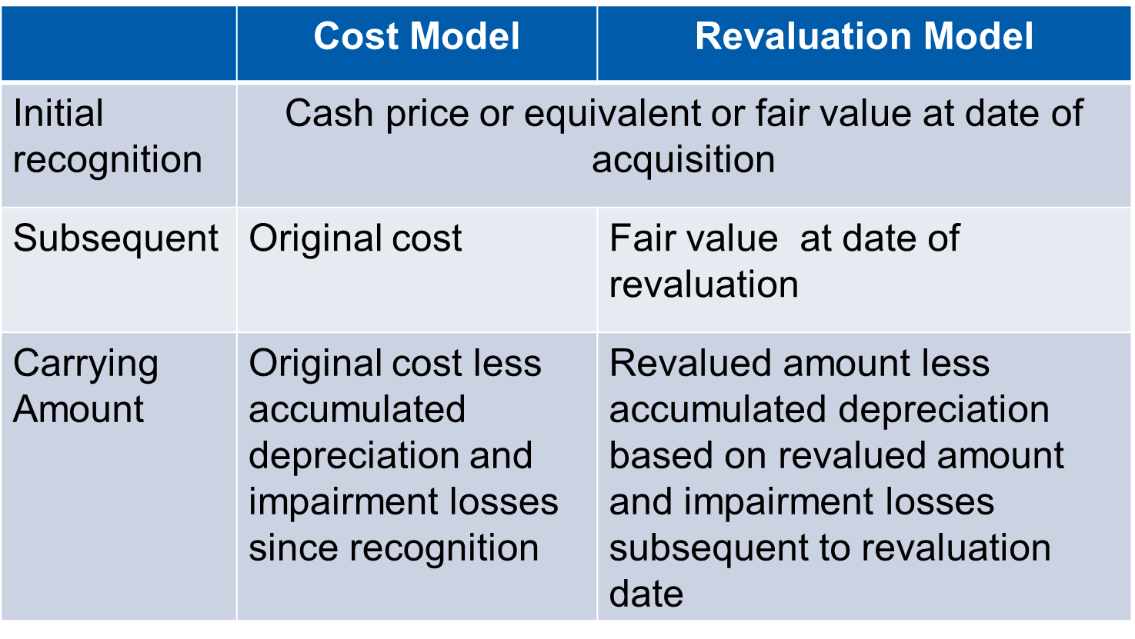
Comparison of Models
Property, Plant and Equipment

Slide 13
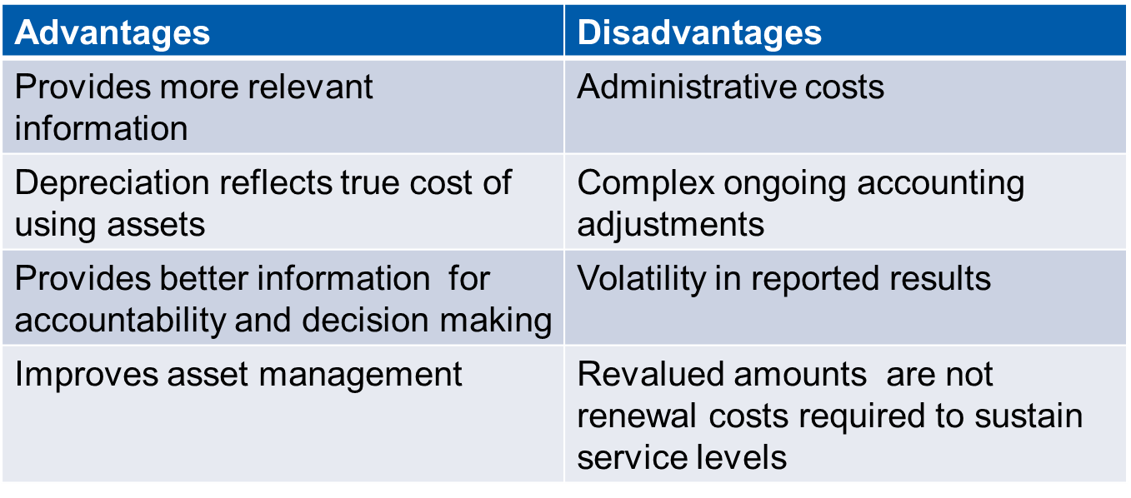
Pros and Cons of Revaluation
Property, Plant and Equipment

Slide 14
Depreciation
All PP&E except land is subject to depreciation
The depreciable amount of an asset is expensed on a systematic basis over its useful life to surplus or deficit for each period unless it is recognized in the carrying amount of another asset
Depreciation begins when an asset is in operation
Reviewed at each annual reporting date
Each significant component is depreciated separately
Property, Plant and Equipment

Slide 15
Depreciation Example
A government has a water treatment facility with the following components:
Assuming was in service Jan 1, 20x0, no residual value and straight line depreciation, what is depreciation for year ended of Dec 31, 20x0? Explain
How should the treatment facility be recognized?
Component | Cost (CU) | Expected Life
Building Structure | 2,000,000 | 40 Years
Roof | 500,000 | 15 Years
Pumps | 1,000,000 | 10 Years
HVAC System | 500,000 | 15 Years
Property, Plant and Equipment
Notes:
The answer to this discussion question is provided in the Assets module (pages 27 - 28).

Slide 16
Derecognition
The carrying amount of PP&E is derecognized:
On disposal
When no future service potential or economic benefits is expected from its use or disposal
Gain or loss on derecognition is included in surplus or deficit
A replaced component is derecognized
Property, Plant and Equipment

Slide 17
PP&E Primary Disclosures
For each class
The measurement bases
The depreciation methods
The useful lives or the depreciation rates used
Gross carrying amount and accumulated depreciations at beginning and end
Reconciliation of opening and closing balances
Specific disclosures for the revaluation model
Other disclosures e.g. restrictions on title, contractual commitments etc.
Property, Plant and Equipment

Slide 18
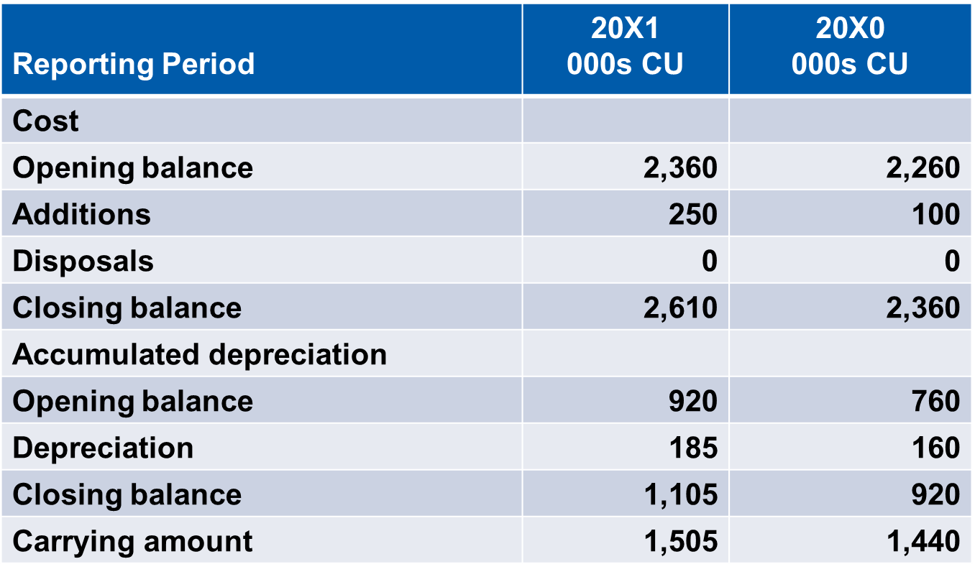
Illustrative Continuity Schedule - Building Class
Property, Plant and Equipment

Slide 19
Borrowing Costs – IPSAS 5
“Benchmark treatment” - borrowing costs expensed in the period incurred
“Allowed alternative treatment” - borrowing costs directly attributable to acquisition of qualifying asset included in cost
Qualifying asset is one that takes a substantial period of time to get ready for its intended use (PP&E, some inventories, intangible assets)
Guidance provided on which costs are eligible
Property, Plant and Equipment
Notes:
IPSAS 5 is based on an earlier version of IAS 23, Borrowing Costs that permitted the benchmark and alternative treatments. IAS 23 now mndates the capitalization of borrowing costs. If participants are familiar with IAS 23, this difference should be highlighted.
IPSAS 5 provides guidance on which costs are eligible for capitalization under the allowed alternative treatment Revised guidance has been included in IPSAS 5 for those entities that have adopted IPSAS 41, Financial Instruments. IPSAS 41 has an effective date of January 1, 2022; however, early adoption is permitted. IPSAS 41 is discussed in the Financial Instruments module.

Slide 20
Impairment – IPSAS 21 and IPSAS 26
A loss in future economic benefits or service potential in excess of depreciation
Assessed at each reporting date
IPSAS 21, Impairment of Non-Cash Generating Assets or IPSAS 26, Impairment of Cash Generating Assets
A cash -generating asset is held with the primary objective of generating commercial return
Non-cash-generating assets are all other assets
Asset is written down to recoverable amount if impaired
Property, Plant and Equipment
Notes:
IPSAS 21 and IPSAS 26 are based on IAS 36, Impairments of Assets.
IPSAS 26 is closely based in IAS 36. IPSAS 21 adapts the principles in IAS 36 to assets where cashflows cannot be used to assess the recoverable amount of the asset. Instead, recoverable service amount is assessed – this is the cost of replacing the service potential of the non-cash-generating asset, and some impairment indicators are modified – see next slide.
If participants are familiar with IAS 36, these differences should be highlighted.
Impairment of goodwill is discussed as part of public sector combinations in the consolidation module.

Slide 21
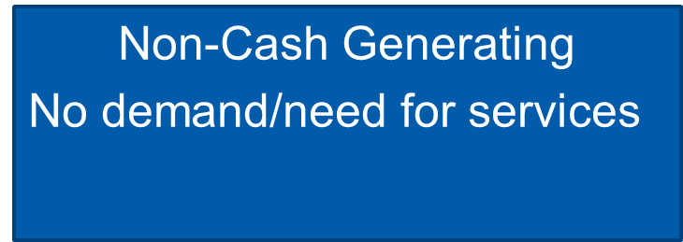
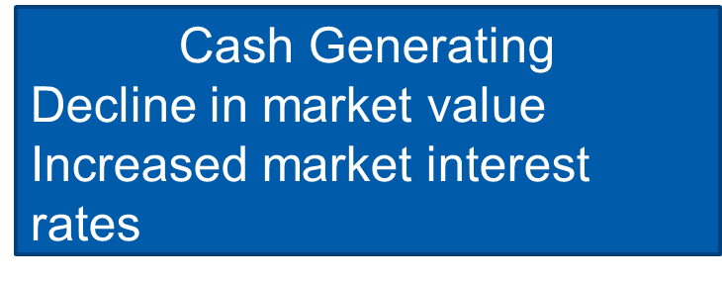
Property, Plant and Equipment
Notes:
See the Assets module for further details (page 34)

Slide 22
Questions and Discussion
Visit the IPSASB webpage http://www.ipsasb.org
Property, Plant and Equipment

