Slide 1
Investment Property
IPSAS® 16
Notes:
IPSAS 16 is based on IAS 40, Investment Property. Participants who are familiar with IAS 40 should be comfortable with IPSAS 16 as long as the key differences are noted.

Slide 2
The Handbook of International Public Sector Accounting Pronouncements is the primary authoritative source of international generally accepted accounting principles for public sector entities.
All information in this presentation is proprietary and copyrighted.
Investment Property

Slide 3
Scope
IPSAS 16 applies to Investment Property, including:
The measurement in a lessee’s financial statements of investment property interests held under a lease accounted for as a finance lease; and
The measurement in a lessor’s financial statements of investment property provided to a lessee under an operating lease.
Investment Property

Slide 4
Definition of Investment Property
Investment property is property (land or a building – or part of a building – or both) held to earn rentals or for capital appreciation, or both, rather than for:
(a) Use in the production or supply of goods or services, or for administrative purposes; or
(b) Sale in the ordinary course of operations.
Investment property is distinguished from owner-occupied property
Owner-occupied property is outside the scope of IPSAS 16
Investment Property
Notes:
The prevalence of investment property in the public sector varies from jurisdiction to jurisdiction – consider whether this is a significant issue for the participants or not.
If participants are not familiar with investment property, consider using the decision tree in the Assets module alongside this slide.

Slide 5
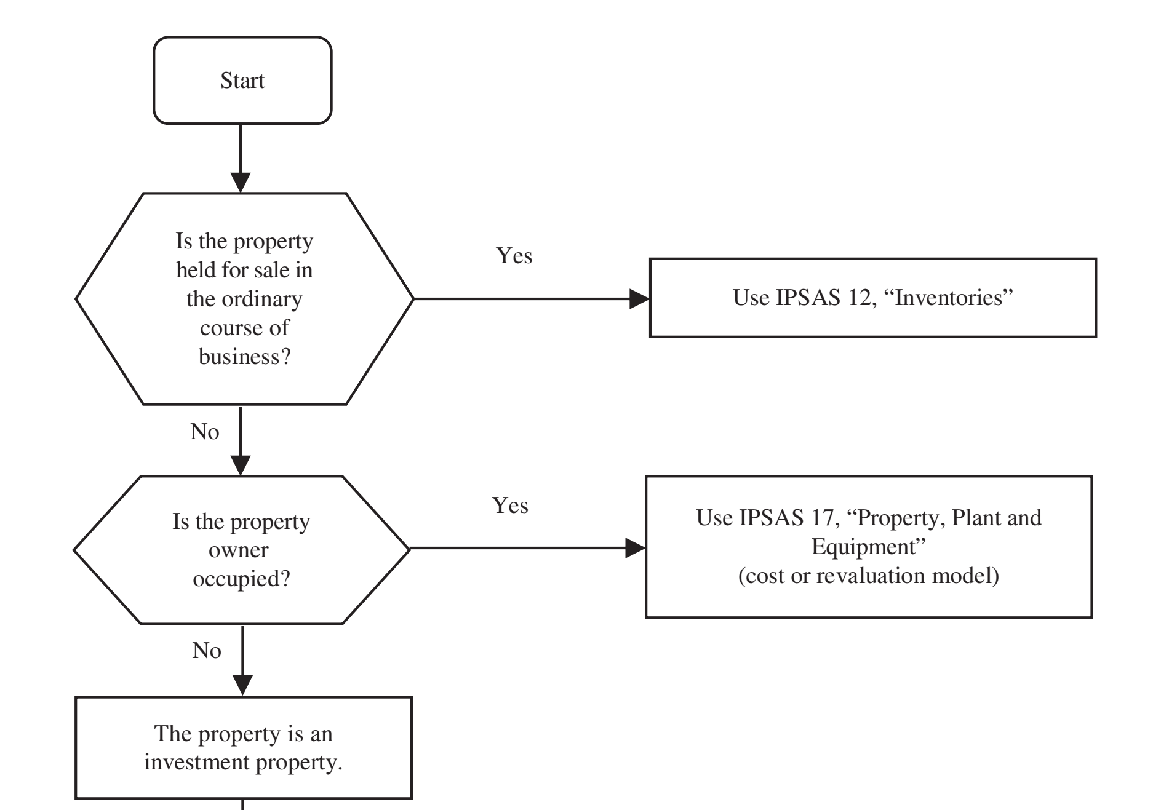
Decision Tree
Investment Property

Slide 6
Examples of Investment Property
Investment Property | Not Investment Property
Land held for long-term capital appreciation | Property held for sale in the ordinary course of operations
Land held for a currently undetermined future use | Property being constructed or developed on behalf of third parties
A building leased out under an operating lease on a commercial basis | Property that is leased to another entity under a finance lease.
A vacant building held to be leased out under an operating lease on a commercial basis | Property held to provide a social service and which also generates cash inflows
Property that is being constructed or developed for future use as investment property | Property held for strategic purposes
Investment Property
Notes:
Consider adding a slide with examples from the participants’ jurisdiction.
Further details are available in the Assets module (page 119).

Slide 7
Worked Example
A Government agency owns a hotel and conference center which it manages. Should the agency classify the hotel and conference center as an investment property?
Investment Property
Notes:
Answer:
A Government agency owns a hotel and conference center which it manages. The services provided to guests are significant to the arrangement as a whole. Therefore, an owner-managed hotel and conference center is owner-occupied property, rather than investment property.

Slide 8
Recognition Principle
Investment property shall be recognized as an asset when, and only when:
(a) It is probable that the future economic benefits or service potential that are associated with the investment property will flow to the entity; and
(b) The cost or fair value of the investment property can be measured reliably.
Investment Property
Notes:
Note that fair value as currently defined in IPSAS is not the same as defined in IFRS 13, Fair Value Measurement. If participants are familiar with IFRS, this difference should be highlighted.

Slide 9
Measurement at Recognition
Investment property shall be measured initially at its cost (transaction costs shall be included in this initial measurement).
Where an investment property is acquired through a non-exchange transaction, its cost shall be measured at its fair value as at the date of acquisition.
Investment Property
Notes:
Note that IAS 40 does not include specific provisions for investment property acquired in a non-exchange transaction. If participants are familiar with IAS 40, this difference should be highlighted.
Note that fair value as currently defined in IPSAS is not the same as defined in IFRS 13, Fair Value Measurement. If participants are familiar with IFRS, this difference should be highlighted.

Slide 10
Subsequent Measurement
An entity may choose its accounting policy in respect of investment property:
Cost model
Investment property is measured in accordance with the cost model in IPSAS 17
The fair value of investment property is disclosed.
Fair value model
Investment Property

Slide 11
Fair Value Model
Investment property is measured at fair value
Use of cost model where, exceptionally, it is clear on initial recognition that the fair value of the investment property is not reliably determinable on a continuing basis
Once measured at fair value, continues to be measured at fair value
Investment property under construction is measured at cost until either its fair value becomes reliably determinable or construction is completed (whichever is earlier)
Fair value reflects market conditions at the reporting date
A gain or loss arising from a change in the fair value of investment property is recognized in surplus or deficit for the period in which it arises
No depreciation or impairment is charged
Investment Property
Notes:
Note that fair value as currently defined in IPSAS is not the same as defined in IFRS 13, Fair Value Measurement. If participants are familiar with IFRS, this difference should be highlighted.
The definition of fair value in IPSAS is:
Fair value is the amount for which an asset could be exchanged, or a liability settled, between knowledgeable, willing parties in an arm’s length transaction.
This includes entry as well as exit values.

Slide 12
Transfers
Transfer from investment property carried at fair value to owner-occupied property or inventories
Cost for subsequent accounting is its fair value at change of use
Transfer from owner-occupied property to investment property carried at fair value
Difference between carrying amount and fair value treated as revaluation in accordance with IPSAS 17
Transfer from inventories to investment property that will be carried at fair value
Difference between carrying amount and fair value recognized in surplus or deficit
Investment Property
Notes:
Transfer from investment property carried at fair value to owner-occupied property or inventories – the subsequent accounting is in accordance with IPSAS 17 (owner-occupied property) or IPSAS 12 (inventory), and its fair value at the change in use is used as the deemed cost for those standards.
Transfer from owner-occupied property to investment property carried at fair value – the difference between the carrying amount and fair value is treated a revaluation – i.e., any gain is taken to revaluation surplus (a revaluation gain on owner occupied property), and not as a gain through surplus or deficit. Compare with transfers from inventory.

Slide 13
Disposals
An investment property shall be derecognized on disposal or when the investment property is permanently withdrawn from use and no future economic benefits or service potential are expected from its disposal
Gains or losses arising from the retirement or disposal of investment property shall be determined as the difference between the net disposal proceeds and the carrying amount of the asset, and shall be recognized in surplus or deficit
Compensation from third parties for investment property that was impaired, lost, or given up shall be recognized in surplus or deficit when the compensation becomes receivable
Investment Property

Slide 14
Investment Property held under an Operating Lease
A property interest that is held by a lessee under an operating lease may be classified and accounted for as investment property if, and only if:
The property would otherwise meet the definition of an investment property
The lessee uses the fair value model for all investment property
Classification available on a property-by-property basis
Disclosure required
Initial cost as prescribed for a finance lease under IPSAS 13, Leases
Liability also recognized as if a finance lease under IPSAS 13
Investment Property
Notes:
Note that IAS 40 has been updated as a result of IFRS 16 Leases replacing IAS 17. Consequently, requirements in IPSAS 16 dealing with leases will be different to the current treatment under IAS 40. If participants are familiar with IAS 40, this should be discussed.

Slide 15
Questions and Discussion
Visit the IPSASB web site http://www.ipsasb.org
Investment Property

