Slide 1
Liabilities
Notes:
Most of the discussion of liabilities – general is based on IPSAS 19, Provisions, Contingent Liabilities and Contingent Assets. This Standard is based on IAS 37. If participants are familiar with IFRS, highlight this point.
IPSAS 19 includes additional guidance on collective and individual services. This is not covered in this module, but is addressed in the Expenses module.

Slide 2
The Handbook of International Public Sector Accounting Pronouncements is the primary authoritative source of international generally accepted accounting principles for public sector entities.
All information in this presentation is proprietary and copyrighted.
Liabilities

Slide 3
Typical Liabilities
Accounts payable and accrued expenses
Provisions
Pensions and other employee benefits
Unearned revenues
Transfer payments payable
Social benefit liabilities
Liabilities

Slide 4
Liability Definition
A liability is a present obligation of the entity for an outflow of resources that results from a past event.
A present obligation is a legally binding obligation (legal obligation) or non-legally binding obligation, which an entity has little or no realistic alternative to avoid.
Liabilities
Notes:
These definitions are taken from the Conceptual Framework.
Where the Conceptual Framework refers to a non-legally binding obligation, IPSAS 19 uses the term constructive obligation.

Slide 5
Liability Recognition Criteria
An item that meets the definition of a liability should be recognized if
It is probable that there will be an outflow of service potential or economic benefits from the entity
The item has a cost or fair value that can be measured reliably
Liabilities

Slide 6
Illustrative Example
An entity has a reporting date of March 31
1. It received 10 trucks on March 15, with payment of CU 500,000 due in thirty days
2. It has outstanding purchase orders totaling CU 100,000 for materials and supplies not yet received
3. It has contracted with an external auditor for audit services related to the reporting period just ended
Question: As at the reporting date, does it report an account payable or accrued expense? If yes, what is the classification? Explain?
Liabilities
Notes:
Answers from Liabilities module:
Scenario 1 - The entity reports an accounts payable on it statement of financial position for the purchase of the trucks even though payment is not due at the period end. The amount has formally been agreed with the supplier. There is no uncertainty as to either the amount or the timing of settlement.
Scenario 2 - An entity has a reporting date of March 31. The entity does not report an account payable or accrued expense for the amount of the outstanding purchase orders. Liabilities only result from a past event, that is, the receipt of materials and supplies. Outstanding purchase orders do meet the definition of a liability until delivery occurs.
Scenario 3 - The entity will generally report an accrued expense on its statement of financial position for the estimated fees for audit services. The audit services relate to the prior period even though they are rendered in the subsequent fiscal period. The requirement to have financial statements may be legislative. The past event that creates the liability is the end of the fiscal period. The services have been agreed with the supplier and relate to the fiscal period. Even though the exact amount of the fees is unknown, they can be reasonably estimated. There is little uncertainty related to timing of settlement. It is often necessary to estimate the amount or timing of the settlement of accrued expenses.

Slide 7
Provisions – Definitions and Recognition
Provisions – liabilities of uncertain timing or amount
Contingent liabilities – possible obligations to be confirmed by occurrence of future events
Accounts Payable
Accruals
Provisions
Contingent Liability
Certainty Continuum
Recognize liability
Recognize liability
Recognize liability
Disclose
Liabilities
Notes:
Payables are liabilities to pay for goods or services that have been received or supplied and have been invoiced or formally agreed with the supplier.
Accruals are liabilities to pay for goods or services that have been received or supplied, but have not been paid,
These are straightforward. Provisions and contingent liabilities are more difficult to determine; and are covered by IPSAS 19.
For entities that are adopting accrual accounting for the first time, identifying provisions and contingent liabilities can be difficult, Consider a discussion on the information participants’ organizations would have to determine provisions (e.g., liability claims). If delivering the training, consider using chat or break-out rooms if the numbers are too large for a single discussion. Legal teams or managers may have records of claims against the organization. Historical data may be useful in assessing the likelihood that a claim will lead to an outflow of resources.

Slide 8
Illustrative Example
A public sector entity operates a nuclear power generation plant. Storage of spent fuel cells complies with legislation. New legislation to be enacted after the reporting date will retroactively change the standards. If enacted, the entity will have to make significant expenditures on storage of spent fuel cells generated from past operations.
Should the entity recognize a provision or disclose a contingent liability at the reporting date? Explain
Liabilities
Notes:
Answer from Liabilities module:
An event that does not give rise to an obligation immediately may do so at a later date, because of changes in the law. In this case, there is no obligation at the reporting date to change the methods used to store spent fuel cells generated from past operations. The requirement to change storage methods will be an obligating event when the new law requires the existing storage methods to be changed even though it may have retroactive effect.
Where details of a proposed new law have yet to be finalized, an obligation arises only when the legislation is virtually certain to be enacted as drafted. However, differences in circumstances surrounding enactment often make it impossible to specify a single event that would make the enactment of a law virtually certain. In many cases, it is not possible to judge whether a proposed new law is virtually certain to be enacted as drafted, and any decision about the existence of an obligation should await the enactment of the proposed law.

Slide 9
Illustrative Example
At the reporting date legal proceedings have been commenced seeking property and punitive damages from a municipality for injuries from an accident. It is alleged the municipality was negligent in maintenance of the road. Legal counsel advises there is a 30% probability that the municipality will be held liable.
Should the entity recognize a provision or disclose a contingent liability ? Explain
Does the answer change if, at the next period end, the probability is assessed as (a) remote or (b) 60% ? Explain
Liabilities
Notes:
Answer from Liabilities module:
1 A provision is a liability of uncertain timing or amount. At the reporting date, the municipality does not have a present obligation as a result of a past event. The existence or non-existence of a present obligation will be determined by the future finding of the court. When an entity determines it is not probable that an outflow due to an obligation will occur, the entity shall not recognize a liability.
2 The contingent liability is continually assessed to determine whether an outflow of resources has become probable. When it is assessed as remote that the local government will be liable, it does not disclose a contingent liability. When it is probable that an outflow of resources will be required (that is, it is more likely than not that a present obligation exists at the reporting date) for an item previously dealt with as a contingent liability, a provision is recognized in the financial statements of the period in which the change in probability occurs provided a reliable estimate can be made of the amount.

Slide 10
Measurement of Provisions
Amount recognized is best estimate of the expenditure required to settle the present obligation at the reporting date
Best estimate is the amount an entity would rationally pay to settle the obligation or to transfer it to a third party at reporting date
Uncertainty is dealt with by various methods
Expected value
Individual most likely outcome
Liabilities
Notes:
Expected value = probability weighted average

Slide 11
Illustrative Example
A government has a legal obligation to remediate a contaminated site. A site assessment has determined two options. The most likely outcome is containment. There is a chance that contamination will have to be removed and treated. Possible outcomes are in the table.
What is the amount of the provision? Explain
Liabilities
Notes:
An expected value approach is appropriate for estimating a provision for a large population of items. In contrast, IPSAS 19 specifies that the individual most likely outcome may be the best estimate of a single obligation. However, the entity considers other possible outcomes. Where other possible outcomes are either mostly higher or mostly lower than the most likely outcome, the best estimate will be a higher or lower amount.
Measuring a liability at the ‘most likely outcome’ may conflict with the principle of measuring liabilities at the ‘amount that an entity would rationally pay to settle the obligation or to transfer it to a third party’. The determination of the amount an entity would rationally pay to settle an obligation or to transfer it to a third party would take into consideration the risks of other potential outcomes. Therefore, measuring the liability at its most likely outcome fails to reflect the uncertainty inherent in the obligation.
If the individual most likely outcome is used in all cases, it could result in two obligations with different risks and uncertainties being measured at the same amount. An expected value approach may also be appropriate for single obligations. In this case, the individual most likely outcome is that containment is successful at a cost of CU 2 million. However there is a significant chance that the possible outcome is higher than the most likely outcome. The best estimate will be a higher amount.
The provision is measured as follows:
(CU 2 million * 70%)+(CU 10 million *30%)= CU 4.4 million

Slide 12
Present Value
Estimate based on present value when time value of money is material
The discount rate used reflects
Current market assessments
Risks specific to the liability
Does not reflect risks for which future cash flow estimates adjusted
Increase in PV due to passage of time is recognized as an interest expense
Liabilities

Slide 13
Future Events
The estimate of the provision should reflect expected future events
Future events may be
Inflation
Changes in technology
Cost reductions due to experience
New legislation
Liabilities
Notes:
See the Liabilities module for further details.

Slide 14
Other Measurement Issues
Gains from disposal of assets not considered in estimate of provision
Reimbursements by another party
A separate asset (not offset against liability)
Not to exceed provision
Expense may be presented net
Liabilities
Notes:
The most common example of a reimbursement by another party is an insurance policy covering the event that gives rise to the liability.

Slide 15
Changes in Provisions
Provisions reviewed at each reporting date
Adjusted to reflect current best estimate
Reversed if not probable settlement required
Change in provision is change in estimate made prospectively (current year result)
Liabilities

Slide 16
Illustrative Example
On January 1, 20X0, an entity puts a nuclear power generation plant in service at cost CU 100 million. There is a legal obligation for decommissioning the plant at the end of its useful life and ongoing management of contaminated material from operations. The plant is depreciated over 40 years on straight line basis.
Should the entity recognize a provision? Why or why not?
If yes, what should the basis of measurement be? Why?
Liabilities
Notes:
Answer from Liabilities module (the liabilities module provides more detail – see page 16)
(a) The entity has a present obligation to decommission (demolition, site remediation, etc.) the plant and manage the contaminated waste material. The past event that created the obligation was the acquisition, development, or construction of the nuclear plant. It is probable that an outflow of resources embodying economic benefits or service potential will be required to settle the obligation.
(b) In this case, the amount recognized as a provision is the best estimate of the expenditure required to decommission the plant and manage the waste material from ongoing operations at the reporting date. The best estimate is the amount an entity would rationally pay to settle the obligation at the reporting date or transfer it to a third party at that time.

Slide 17
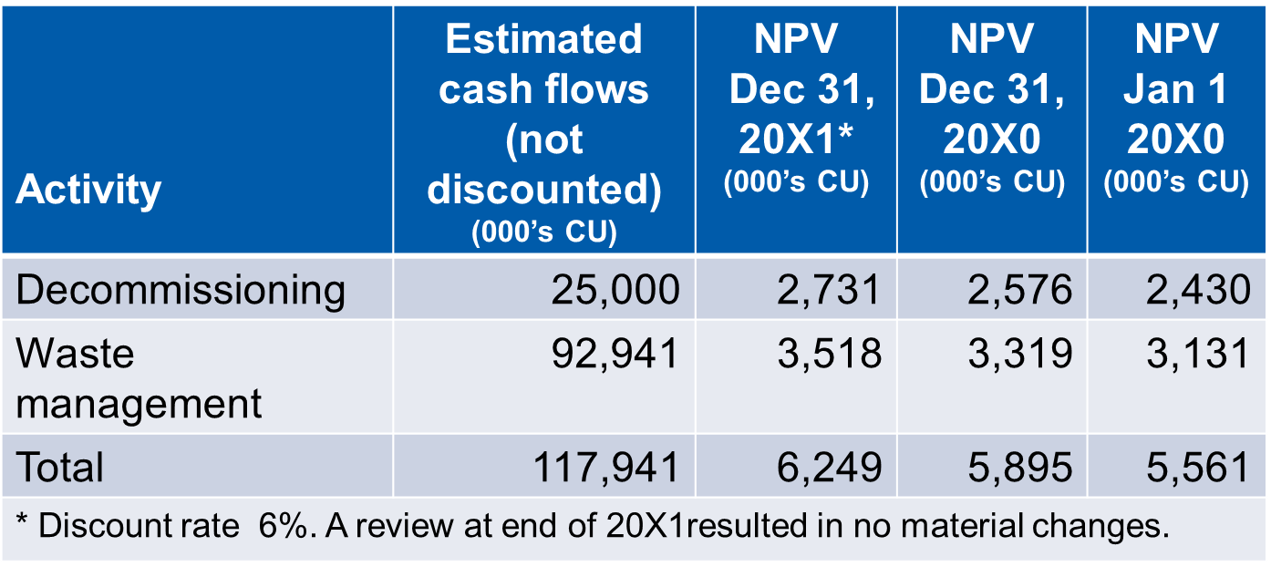
Estimates
What is the provision at December 31, 20X0 and 20X1?
What is the original cost of the plant?
What are the annual expenses for 20X0 and 20X1?
Liabilities
Notes:
The Liabilities module provides a template for answering the question, plus a worked answer (see pages 17 – 18)

Slide 18
Other Provisions
Provisions recognized for costs of obligations under a contract expected to exceed economic benefit or service potential from it - an ‘onerous contract’
Provisions recognized for direct expenditures arising from restructuring
If either are relevant to your situation, refer directly to IPSAS 19
Liabilities

Slide 19
Disclosures
For each class of provision
Opening and closing carrying amount
Additional provisions or increases in provisions
Amounts used
Amounts reversed
Increase in present value from the passage of time
Effect of a change in the discount rate
Description of nature and timing
Uncertainties and major assumptions
Expected reimbursements
Liabilities

Slide 20
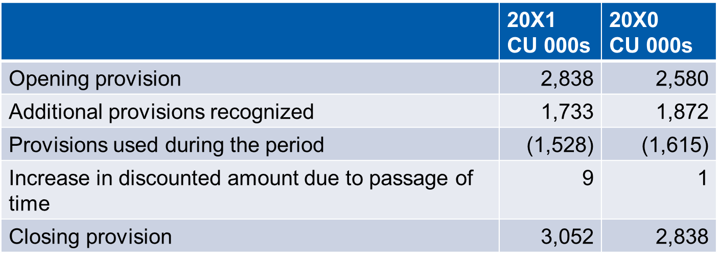
Note Disclosure Example
The Government has recognized a provision for the estimated costs related to the remediation of contaminated sites and restoration of certain assets where the it is obligated, or likely obligated to incur such costs as follows:
Liabilities

Slide 21
Questions and Discussion
Visit the IPSASB web site http://www.ipsasb.org
Liabilities

