Slide 1
Revenue from Exchange Transactions
IPSAS® 9
Notes:
IPSAS 9 is based on IAS 18, Revenue. For participants who are familiar with IFRS, this could be emphasized. Note that IAS 18 has been withdrawn by the IASB; IFRS 15. Revenue from Contracts with Customers is effective from January 1, 2018. The IPSASB’s proposals in response to IFRS 15 are considered later in this module.
Not all public sector organizations receive revenue from exchange transactions; consider the relevance of this topic for participants.

Slide 2
The Handbook of International Public Sector Accounting Pronouncements is the primary authoritative source of international generally accepted accounting principles for public sector entities.
All information in this presentation is proprietary and copyrighted.
Revenue from Exchange Transactions

Slide 3
Recognition and Measurement
Revenue recognized from
Rendering of services on percentage completion method
Sale of goods when significant risks and rewards of ownership and effective control transferred
Interest on time proportion basis using effective yield
Royalties as earned
Dividends when right to receive payment established
Measured at fair value of consideration
Recognized when recognition criteria met
Revenue from Exchange Transactions
Notes:
Note that fair value as currently defined in IPSAS is not the same as defined in IFRS 13, Fair Value Measurement. If participants are familiar with IFRS, this difference should be highlighted.
The definition of fair value in IPSAS is:
Fair value is the amount for which an asset could be exchanged, or a liability settled, between knowledgeable, willing parties in an arm’s length transaction.
This includes entry as well as exit values.

Slide 4
Rendering Services
Recognize by reference to stage of completion at reporting date
Conditions:
Amount of revenue can be measured reliably
Probable that service potential or economic benefits will flow to the entity
Stage of completion can be measured reliably
Costs incurred and costs to complete can be measured reliably
Revenue from Exchange Transactions

Slide 5
Examples of Rendering Services
Housing
Transportation
Managing toll roads
Financial services fees
Admission fees
Tuition fees
Franchise or concession fees
Revenue from Exchange Transactions
Notes:
Consider adding local examples if participants’ organizations receive revenue from exchange transactions.
Discuss whether these transactions are exchange transactions or non-exchange transactions in the participants’ jurisdiction. Practice varies from country to country. This issue is discussed in more detail later in this module (revenue from non-exchange transactions: transfers). Consider whether this discussion needs to be included in this section as well.

Slide 6
Sale of Goods
Recognize revenue from the sale of goods when all the following conditions have been satisfied:
The entity has transferred to the purchaser the significant risks and rewards of ownership of the goods;
The entity retains neither continuing managerial involvement to the degree usually associated with ownership nor effective control over the goods sold;
The amount of revenue can be measured reliably;
It is probable that the economic benefits or service potential associated with the transaction will flow to the entity; and
The costs incurred or to be incurred in respect of the transaction can be measured reliably.
Revenue from Exchange Transactions
Notes:
Consider adding local examples if participants’ organizations receive revenue from exchange transactions.
These are likely to be more clear-cut than the provisions of services.

Slide 7
Other Exchange Revenues
Interest
Royalties
Dividends
Revenue from Exchange Transactions
Notes:
See Revenues module for more details (page 20).

Slide 8
Revenue Recognition
A government invoices for water consumed in arrears. Consumption is evenly spread over billing periods. Estimated unbilled consumption for Group A for Dec 20X1 is CU 200,000. Amounts are posted to the general ledger when invoices are issued.
What is the adjustment made to revenue for the period ended December 31, 20X1? Explain
Revenue from Exchange Transactions
Notes:
The answer to this discussion question is provided in the Revenues module (page 21).

Slide 9
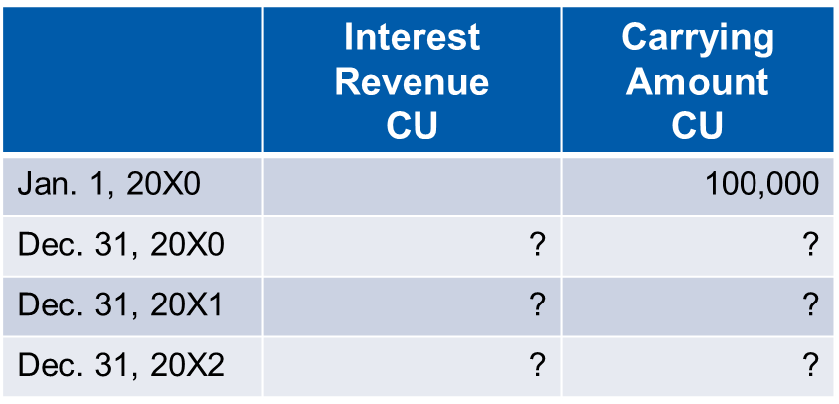
Interest Revenue
An entity with a December 31 year end holds a 3 year debenture. It receives a payment at maturity January 1, 20X3 of CU 115,763. The effective yield is 5%. Complete the table. (For ease of calculation, interest is accrued on annual basis)
Revenue from Exchange Transactions
Notes:
The answer to this discussion question is provided in the Revenues module (page 22).

Slide 10
Illustrative Note Disclosure
Note X - Sales of Goods and Services
Revenue is recognized when services are rendered or title to goods are transferred. The revenue reported is comprised of the following items:
Revenue from Exchange Transactions

Slide 11
Questions and Discussion
Visit the IPSASB web site http://www.ipsasb.org
Revenue from Exchange Transactions

