Slide 1
Financial Instruments –
Disclosures (IPSAS® 29)
Notes:
This presentation covers the disclosure requirements in IPSAS 30 that relate to IPSAS 29.
The IPSASB issued IPSAS 41, Financial Instruments, in August 2018. IPSAS 41 has an effective date of January 1, 2023 (with early adoption permitted) and will supersede IPSAS 29. IPSAS 41 will modify the disclosure requirements in IPSAS 30 so that they are appropriate for the new financial instruments accounting.
Entities that have yet to adopt the financial instrument standards are advised to adopt IPSAS 41 rather than IPSAS 29, as this will avoid the need for subsequent accounting policy changes. Where participants are from such entities, it is recommended that the training include the Disclosures (IPSAS 41) presentation and module, not this one.
This presentation is intended for use with participants whose organizations have adopted , or are in the process of adopting, IPSAS 29. Depending on the purpose of the training, such participants may also benefit from the IPSAS 41 presentation, so that they are aware of the forthcoming changes.
IPSAS 29 is based on IAS 39 (which has been superseded by IFRS 9). If participants are familiar with IFRS, consider highlighting this issue. IPSAS 41 is based on IFRS 9 (the current IFRS).
IPSAS 30 is based on IFRS 7 – this session is based on the version of IFRS 7 that applied to IAS 39; IFRS 9 modified IFRS 7 in the same way that IPSAS 41 will modify IPSAS 30.

Slide 2
The Handbook of International Public Sector Accounting Pronouncements is the primary authoritative source of international generally accepted accounting principles for public sector entities.
All information in this presentation is proprietary and copyrighted.
Financial Instruments

Slide 3
Disclosure Requirements
Disclosures allow users information to evaluate the financial instruments of the entity and understand the nature and extent of risks from such instruments. Required items to disclose are as follows:
Carrying amounts of each category of financial instrument
Fair value measurements and fair value hierarchy level
Revenue, expense, gains, or losses
Net gains or losses by category
Interest revenue and expense
Impairment losses
Information about hedges
Information about concessionary loans
Nature, types and extent of risks
Financial Instruments
Notes:
This slide summarizes the disclosures required, which are extensive. The module Financial Instruments Disclosures (IPSAS 29) provides further details (starting from page 50).
For transparency reasons, it may be appropriate to disclose loans given or received in response to the COVID-19 pandemic separately from other loans. Consider a discussion on this topic (use chat or break-out rooms if providing the training online). This discussion could start with a show of hands (poll if online) to see how many participants think COVID-19 loans should be disclosed separately.
The fair value hierarchy has the following levels:
Level 1 - Quoted prices (unadjusted) in active markets for identical assets or liabilities;
Level 2 - Inputs other than quoted prices that are observable for the asset or liability, either directly (i.e., as price) or indirectly (i.e., derived from prices); and
Level 3 - Inputs for the asset or liability that are not based on observable market data (unobservable inputs).

Slide 4
Accounting Policy Note
The Commission makes the following classifications of its financial assets and financial liabilities
Cash is classified as "assets held for trading through surplus or deficit" and is measured at fair value
Accounts receivable are classified as "loans and receivables" and are measured at amortized cost
Accounts payable and accrued liabilities, other liabilities and long term financing are classified as "other financial liabilities" and are initially measured at fair value
Financial Instruments
Notes:
Example of an accounting policy disclosure for financial instruments. See the module Financial Instruments Disclosures (IPSAS 29) for further details.
If participants’ organizations disclose accounting policies in respect of financial instruments, consider a discussion as to what is included in their policies (consider using chat or break-out rooms if delivering the training online).
Additional policies would be needed to address concessionary loans given/received - e.g., in response to the COVID-19 pandemic.

Slide 5
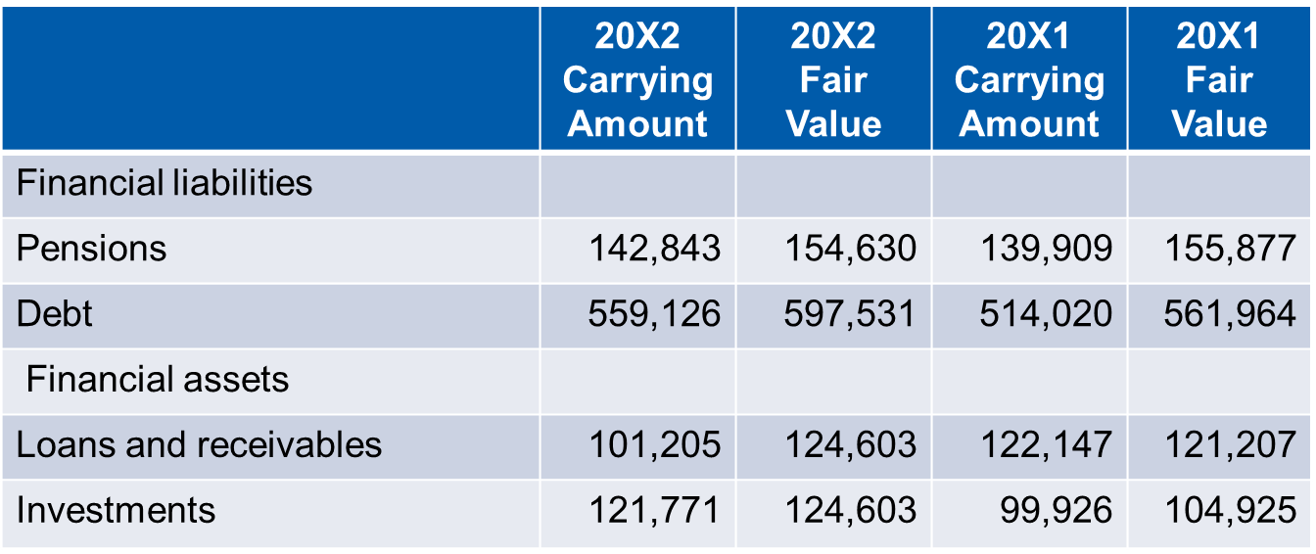
Carrying Amount and Fair Value Illustrative Note Disclosure
The following table presents the carrying amounts and fair values of liabilities and financial assets. Fair values are Government estimates and are generally calculated using market conditions at a specific point in time.
Financial Instruments
Notes:
Example of an note disclosure. See the module Financial Instruments Disclosures (IPSAS 29) for further details.
Concessionary loans (e.g., in response to the COVID-19 pandemic) are likely to be disclosed separately.

Slide 6
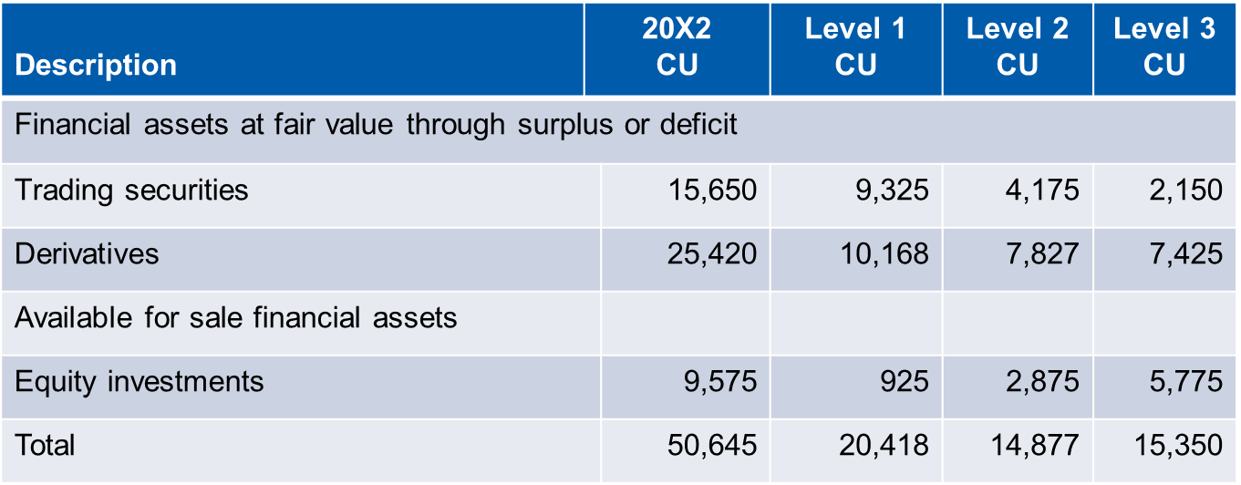
Fair Value Hierarchy
The following table shows the fair value hierarchy for fair value measurements of financial assets recognized in the statement of financial position.
Financial Instruments
Notes:
Example of an note disclosure. See the module Financial Instruments Disclosures (IPSAS 29) for further details.

Slide 7
Credit Risk
Note X - Credit Risk
The use of derivatives introduces the credit risk of a counterparty defaulting on contractual obligations. The Province manages its credit risk by dealing only with high credit quality counterparties and entering into contractual agreements that provide for termination netting . The table below presents the gross credit risk for the derivative financial instrument portfolio.
Financial Instruments
Notes:
Example of a note disclosure.
The above is an illustration of a disclosure an entity may make in compliance with IPSAS 30 related to credit risk. The illustrative note is of necessity abbreviated. Participants should consult IPSAS 30 for more the detailed disclosure requirements.

Slide 8
Questions and Discussion
Visit the IPSASB web site http://www.ipsasb.org
Financial Instruments

