Slide 1
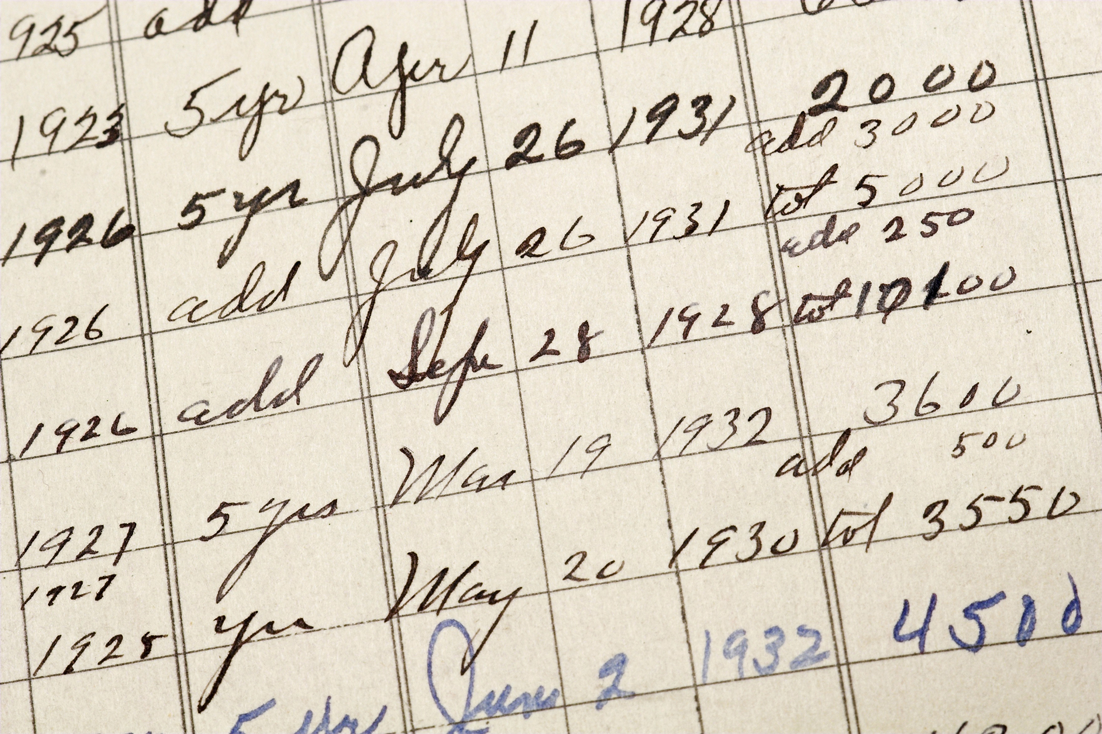
First-time Adoption of Accrual Basis IPSAS®
Notes:
This module is intended to be used with participants who are in the process of adopting accrual basis IPSAS, or who are intending to adopt accrual basis IPSAS. It will not be relevant to participants who have already completed the process of adopting accrual basis IPSAS, and may be less relevant to participants who are only considering adopting accrual basis IPSAS.
This module consists of two parts.
Part 1 discusses IPSAS 33, First-time Adoption of Accrual Basis IPSAS, and the exemptions that this standard offers to entities that are adopting accrual basis IPSAS for the first time. IPSAS 33 allows a three-year transition period during which exemptions from the full requirements of IPSAS may be applied. Note that IPSAS 33 is not based on IFRS 1 – this is because IFRS 1 assumes entities have previously applied national accrual based accounting standards. IPSAS 33 is intended to be applied by entities that may have previously applied cash accounting, or modified cash or modified accrual accounting as well as those that have previously applied national accrual based accounting standards.
Part 2 is intended to be used in discussing the practical issues that participants may experience in adopting accrual basis IPSAS for the first time. Because these issues will vary from jurisdiction to jurisdiction, depending on the information available, the previous basis of accounting, and the extent to which transactions occur, this training material highlights issues that might arise but does not propose any solutions. It is recommended that this part of the presentation is tailored to the participants’ needs and local factors. The introduction to this material provides a list of sources for further guidance that may be helpful in tailoring this material.

Slide 2
The Handbook of International Public Sector Accounting Pronouncements is the primary authoritative source of international generally accepted accounting principles for public sector entities.
All information in this presentation is proprietary and copyrighted.
First-time Adoption of Accrual Basis IPSAS

Slide 3
Structure of Module
IPSAS 33 First-time Adoption of Accrual Basis International Public Sector Accounting Standards® (IPSAS)
Practical Issues
First-time Adoption of Accrual Basis IPSAS

Slide 4
IPSAS 33 - Objective
Financial Statements will include information:
That provides transparent reporting about a first-time adopter’s transition to accrual basis IPSAS;
That provides a suitable starting point for accounting in accordance with accrual basis IPSAS irrespective of the basis of accounting the first-time adopter has used prior to the date of adoption; and
Where the benefits are expected to exceed the costs.
First-time Adoption of Accrual Basis IPSAS
Notes:
Because IPSAS 33 allows a three-year transition period during which exemptions from the full requirements of IPSAS may be applied, it may not be clear which assets and liabilities are included in the financial statements. This can make them difficult to use. IPSAS 33 requires a first-time adopter to be transparent about what item are included, and what items are not included, in the financial statements.
The three year transition period is intended to allow entities to adopt the accrual basis IPSAS in a cost-effective manner. Note that for many entities, significant work will be required prior to the transition period permitted by IPSAS 33. Adopting accrual basis IPSAS will often take longer than three years, and IPSAS 33 shouldn’t be used until entities are close to finalising the transition.
There is no requirement to use IPSAS 33 – other approaches (such as a phased approach) are possible. However, compliance with IPSAS can only be claimed once all IPSAS are complied with, and financial statements should only be described as transitional IPSAS financial statements where they are prepared in accordance with IPSAS 33.

Slide 5
IPSAS 33 - Objective
Addresses different types of transition to accrual IPSAS
Transition starting point may be reporting on:
A cash basis
An accrual basis under another reporting framework
A modified version of either the cash or accrual basis of accounting
First-time Adoption of Accrual Basis IPSAS
Notes:
Consider adding details of local situation; and if a modified cash or modified accrual approach is currently being taken, identifying which items are accounted for on a cash basis, and which on an accrual basis.

Slide 6
IPSAS 33 - Scope
Applies from the date on which first-time adopter adopts accruals-basis IPSAS and during the period of transition
IPSAS 33 is last stage of adoption process
Road map / plan needed to reach that point
First-time Adoption of Accrual Basis IPSAS
Notes:
IPSAS 33 allows a three-year transition period – so need to be certain that can complete the transition to accrual basis IPSAS in that three years. If participants have doubts, it may be better to delay using IPSAS 33. This doesn’t necessarily lengthen the process. IPSAS 33 allows up to three years for transition, but shorter period can be used. IPSAS 33 sets the maximum period over which transitional IPSAS financial statements can be produced.

Slide 7
IPSAS 33 – Scope and Definitions
Date of Adoption of IPSAS
Start of first reporting period
First transitional IPSAS
Financial statements
End of transition period
First IPSAS financial
statements
Transition period
Business as usual
Process Starts
Preparation
Planning
IPSAS 33
First-time Adoption of Accrual Basis IPSAS
Notes:
Note that this slide is animated.
It is important to note that a significant amount of planning and preparation is required before entities will be ready to start applying IPSAS 33. IPSAS 33 is the end of the process, not the start.

Slide 8
IPSAS 33 – Recognition and Measurement
Opening statement of financial position
At the date of adoption of IPSAS
Accounting policies
IPSAS applied retrospectively except where IPSAS 33 requires or permits alternative approach
Applied consistently to all periods except as specified in IPSAS 33
Are amended during transition period as entity stops relying on exemptions
First-time Adoption of Accrual Basis IPSAS
Notes:
Accounting policies will be amended during the transition period as the entity stops relying on exemptions. For example, in the first year an entity’s accounting policy may be to not recognize property, plant and equipment, but to expense all the payments. This will change during the transition period to implement the accounting policies necessary to recognize, measure, depreciate etc. property, plant and equipment.

Slide 9
IPSAS 33 – Exceptions to retrospective application of IPSAS
Estimates consistent with estimates made in accordance with the previous basis of accounting
Adjusted to reflect differences in accounting policies
Further information after date of adoption of IPSAS treated as non-adjusting event
Estimates required for items not recognized under previous basis of accounting
Reflect conditions at date of adoption of IPSAS or date during period of transition if recognized later
First-time Adoption of Accrual Basis IPSAS
Notes:
For further details see the First-time Adoption of Accrual Basis IPSAS module (page 7).

Slide 10
IPSAS 33 – Fair Presentation and Compliance with IPSAS
A first-time adopter’s first IPSAS financial statements shall fairly present: the financial position, financial performance, and cash flows of the entity
Some exemptions affect fair presentation and compliance with IPSAS
If using these exemptions, prepare transitional IPSAS financial statements
Consider materiality in assessing fair presentation and compliance
First-time Adoption of Accrual Basis IPSAS
Notes:
Highlight the differences between an entity’s first IPSAS financial statements and its transitional financial statements.
For further details see the First-time Adoption of Accrual Basis IPSAS module (pages 7 - 8).

Slide 11
IPSAS 33 – Optional Exemptions
Exemptions
Affect Fair Presentation and Compliance
Do Not Affect Fair Presentation and Compliance
Three year transition period
First-time Adoption of Accrual Basis IPSAS

Slide 12
IPSAS 33 – Exemptions affecting Fair Presentation and Compliance
Three-year exemption for recognizing and/or measuring assets and liabilities:
Inventories
Investment property
Property, plant and equipment
Defined benefit plans and other long-term employee benefits
Biological assets and agricultural produce
Intangible assets
Service concession assets and related liabilities
Financial instruments
Social Benefits
First-time Adoption of Accrual Basis IPSAS
Notes:
For further details see the First-time Adoption of Accrual Basis IPSAS module (starting page 9).

Slide 13
IPSAS 33 – Exemptions affecting Fair Presentation and Compliance
Three-year exemption for recognizing and measuring non-exchange revenue
Exemptions where related assets / liabilities not recognized or measured
Borrowing costs
Leases
Provisions, contingent liabilities and contingent assets
Public sector combinations
Related party disclosures
Interests in other entities
First-time Adoption of Accrual Basis IPSAS
Notes:
Exemptions where related assets / liabilities not recognized or measured: for example, if an entity does not recognize property, plant and equipment, it can’t capitalize borrowing costs under IPSAS 5. Similarly, until an entity is recognizing all assets and liabilities, it can’t recognize goodwill from an acquisition (public sector combination) under IPSAS 40. These are explained in the module (starting page 9).

Slide 14
IPSAS 33 – Exemptions not affecting Fair Presentation and Compliance
Using deemed cost to measure assets and/or liabilities
Inventory
Investment property
Property, plant and equipment
Intangible assets (subject to conditions)
Financial instruments
Service concession assets
Only where acquisition cost not available
Deemed cost is fair value or previous valuation amount
First-time Adoption of Accrual Basis IPSAS
Notes:
For further details see the First-time Adoption of Accrual Basis IPSAS module (page 11).

Slide 15
IPSAS 33 – Exemptions not affecting Fair Presentation and Compliance
Comparative information and historical summaries (financial statements)
Effects of changes in foreign exchange rates
Borrowing costs
Leases
Segment reporting
Impairment
Employee benefits
Financial instruments
Intangible assets
Service concession arrangements
Interest in other entities
Social Benefits
First-time Adoption of Accrual Basis IPSAS
Notes:
For further details see the First-time Adoption of Accrual Basis IPSAS module (page 11).
Some of the exemptions require a detailed knowledge of the IPSAS – consider what is relevant to the participants.

Slide 16
IPSAS 33 – Disclosures
Information for users of the transitional financial statements
Disclosures during the transition period:
Explanation of transition to IPSAS
Reconciliations
Disclosures where deemed cost is used
Exemptions from disclosures in IPSAS
First-time Adoption of Accrual Basis IPSAS
Notes:
For further details see the First-time Adoption of Accrual Basis IPSAS module (page 16).

Slide 17
IPSAS 33 – Comprehensive Coverage
IPSAS 33 lists all applicable exemptions
Comprehensive coverage of transition issues
IPSAS 33 is a “one-stop shop”
Helpful because everything gathered together in one place
First-time Adoption of Accrual Basis IPSAS

Slide 18
Useful information for first-time adoption.
Study 14, Transition to the Accrual Basis
Guidance for governments and government entities
Practically oriented (“How to do it”)
Includes suggestions on project management
Non-authoritative (Not an IPSAS)
Case Studies on IPSASB web site
Costa Rica
Guatemala
Malta
Malaysia
Panama
Switzerland
First-time Adoption of Accrual Basis IPSAS
Notes:
The rest of this module is intended to be used in discussing the practical issues that participants may experience in adopting accrual basis IPSAS for the first time. Because these issues will vary from jurisdiction to jurisdiction, depending on the information available, the previous basis of accounting, and the extent to which transactions occur, this training material highlights issues that might arise but does not propose any solutions. It is recommended that this part of the presentation is tailored to the participants’ needs and local factors. The introduction to this material provides a list of sources for further guidance that may be helpful in tailoring this material.
Consider which topics will be most relevant to the participants. For example, if an entity is working on identifying assets, the emphasis of the training could be on that issue.

Slide 19
Challenges
Need to make cultural and mind-set changes – from using cash basis to accrual basis
Overcome resistance to change
Integration of information technology systems
Integration of departmental and accounting records
Developing asset registers – property, plant and equipment including infrastructure assets
Consolidations
First-time Adoption of Accrual Basis IPSAS

Slide 20
Critical Success Factors
Strong political support at the highest level of elected officials
Commitment to implementation from senior appointed officials
Initial budget, project planning and gap analysis
Identify needs—information systems, training, legislation, external support, project budget
Staff open to training and will accept an accrual accounting perspective
Recognition that reform is for enhanced financial management not merely a book-keeping exercise
First-time Adoption of Accrual Basis IPSAS

Slide 21
Lessons
IPSAS adoption should be treated as an integrated whole and as a country priority
Active support at top (political and managerial) across government, including “IPSAS champion”
Need a comprehensive implementation plan with realistic times, flexibility and permission to modify
Effective project manager and project team
Effective use of limited resources
Effective “learn-do” theory and practice
First-time Adoption of Accrual Basis IPSAS

Slide 22
Lessons
Effective communication strategy
Information technology systems reform an integrated part from beginning
Effective training on meaning and use of accrual information
Need to move away from day-to-day activities – retreat and workshops
Tackle asset inventory early – don’t leave it to the end
Not necessary to go to IPSAS cash first (some governments have found this beneficial)
First-time Adoption of Accrual Basis IPSAS

Slide 23
Risk Approach
Risk Analysis – Impact and Likelihood
Concentrate on High Impact, High Likelihood
Low Impact – Material?
Low Likelihood - Limited Review?
First-time Adoption of Accrual Basis IPSAS

Slide 24
People
Change Management Project
Project Group
Communications
Sell Benefits
Finance Teams
Other Staff
Managers / Budget Holders
Information Providers
Training
First-time Adoption of Accrual Basis IPSAS

Slide 25
Political Support
Project
Leadership
Legislation
Resources
Example Issues
Assets Identified
Aged Bad Debts
Credit Rating Agencies
First-time Adoption of Accrual Basis IPSAS

Slide 26
Practical Issues: Current Assets
Item | Cash Basis | Source of Information
Cash and Cash Equivalents | Confirm includes cash equivalents | Policy on Cash Equivalents Investment Records
Receivables (Exchange / Non-Exchange) | Not included | Debtors Records Measurement? Current / Long Term Split?
Current Portion of Long-Term Receivables | Not included | Debtors Records Measurement? Current / Long Term Split?
Inventory | Not included | Inventory Records? Measurement?
First-time Adoption of Accrual Basis IPSAS

Slide 27
Practical Issues: Non-Current Assets
Item | Cash Basis | Source of Information
Property, Plant, and Equipment | Not included | Asset Register? Utility Bills Property Tax Records
Intangible Assets | Not included | Inventory Records Unlikely to have information re internally generated intangible assets
Long-Term Receivables | Not included | Debtors Records Measurement? Current / Long Term Split?
Investments | Not included | Investment Records? Measurement? Current / Long Term Split?
First-time Adoption of Accrual Basis IPSAS

Slide 28
Practical Issues: Current Liabilities
Item | Cash Basis | Source of Information
Trade and Other Payables | Not included | Creditors Records Measurement? Current / Long Term Split?
Provisions | Not included | Processes for Identification? Legal Teams Managers
Borrowing | Not included | Borrowing Records Measurement? Current / Long Term Split?
Employee Benefits (Current) | Not included | HR Systems Actuaries? Sampling (e.g., accumulated leave)
First-time Adoption of Accrual Basis IPSAS

Slide 29
Practical Issues: Non-Current Liabilities
Item | Cash Basis | Source of Information
Employee Benefits (Non-Current) | Not included | HR Systems Actuaries (Especially Defined Contribution Pensions)
Finance Leases | Not included | Processes for Identification? Legal Records? Property Records? Classification & Measurement
Long-Term Borrowing | Not included | Borrowing Records Measurement? Current / Long Term Split?
Service Concession Arrangements | Not included | Contracts Classification & Measurement
First-time Adoption of Accrual Basis IPSAS

Slide 30
Practical Issues: Net Assets / Equity
Item | Cash Basis | Source of Information
Reserves | Not included | Records of Decisions Ministerial Administrative
Accumulated Surplus Or Deficit | Balance; will not include all adjustments for accrual items | Adjustments via Accumulated Surplus or Deficit Can be Calculated by Difference
First-time Adoption of Accrual Basis IPSAS

Slide 31
Adjustments through Accumulated Surplus or Deficit
Cash at Bank | 10,350
Total Assets | 10,350
Accumulated Surplus / Deficit | 10,350
Property, Plant and Equipment | 105,250
Cash at Bank | 10,350
Total Assets | 115,600
Accumulated Surplus / Deficit | 115,600
Property, Plant and Equipment | 105,250
Cash at Bank | 10,350
Total Assets | 115,600
Loans | (104,500)
Total Liabilities | (104,500)
Accumulated Surplus / Deficit | 11,100
First-time Adoption of Accrual Basis IPSAS

Slide 32
Questions and Discussion
Visit the IPSASB web site http://www.ipsasb.org
First-time Adoption of Accrual Basis IPSAS

